Slide 1
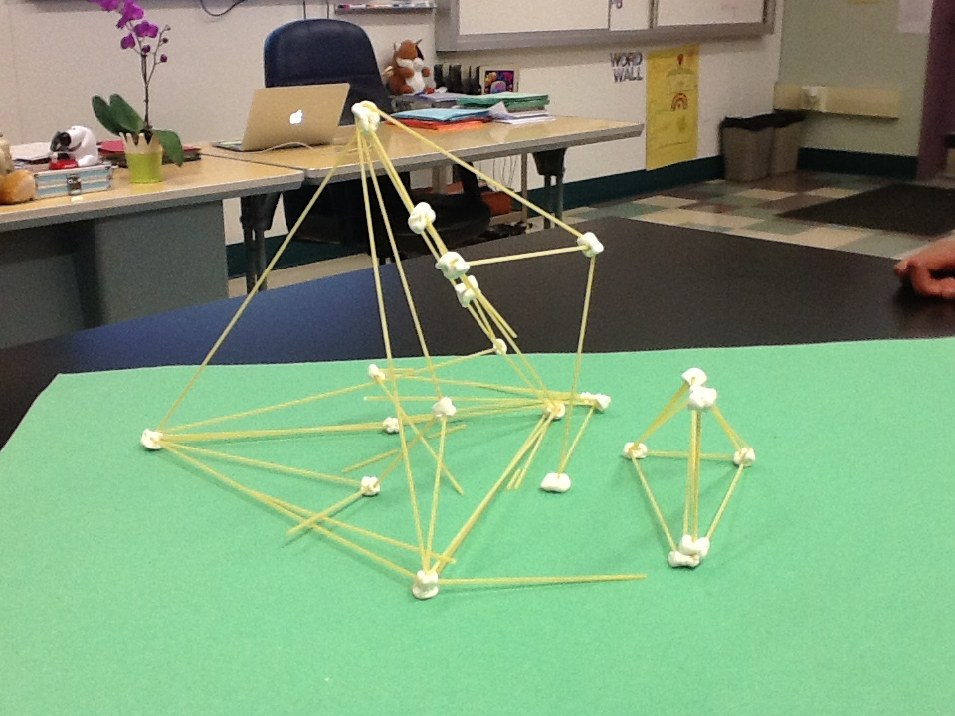
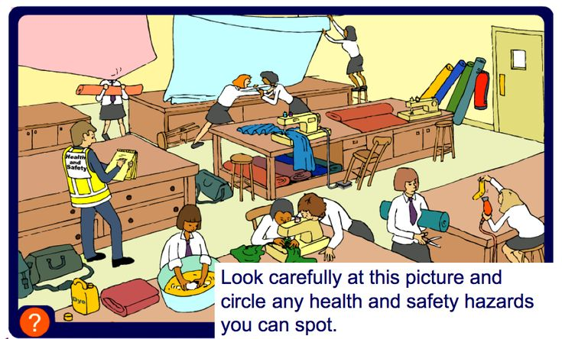
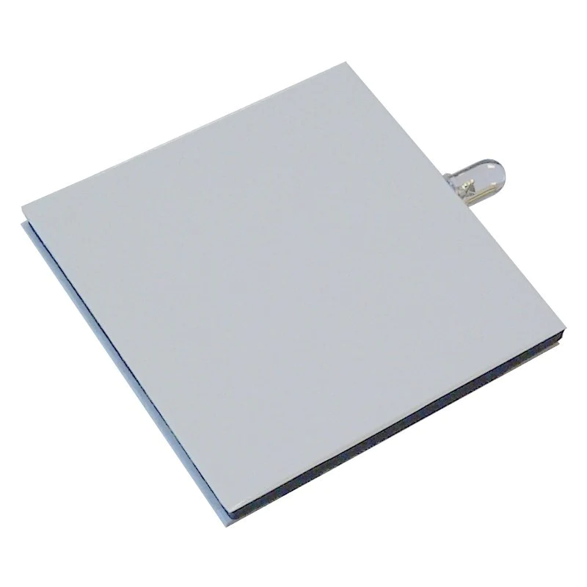
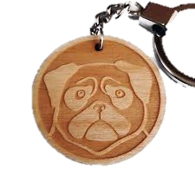
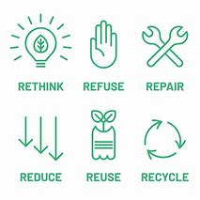
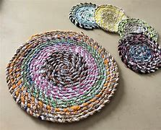
Design Technology Year 7 Learning Journey
Year 7
Health and Safety in the Workshop.
Use the picture to identify unsafe practices. Write a list of 10 safety rules, identify a class contract for behaviour and H&s
Dyson Challenge – Straw Bridges
Look at the use of triangulation in structures and the ability to create a strong bridge using paper straws.
Basic Circuits. Follow a simple plan/order of make to construct a small squeezy torch. Look at Input – Process - output
Introduction to Acrylic
Mini D&M project – Keyring. Research thermoplastics and thermosetting plastics.
Introduction to C.A.D – Techsoft and
the laser cutter.
Laser cut – key ring design. Have an understanding of etching and cutting.
Year 8
Textiles and the 6R’S
Follow a simple plan/order of make to construct a small Textiles product. ‘Make Do and Mend’

Slide 2
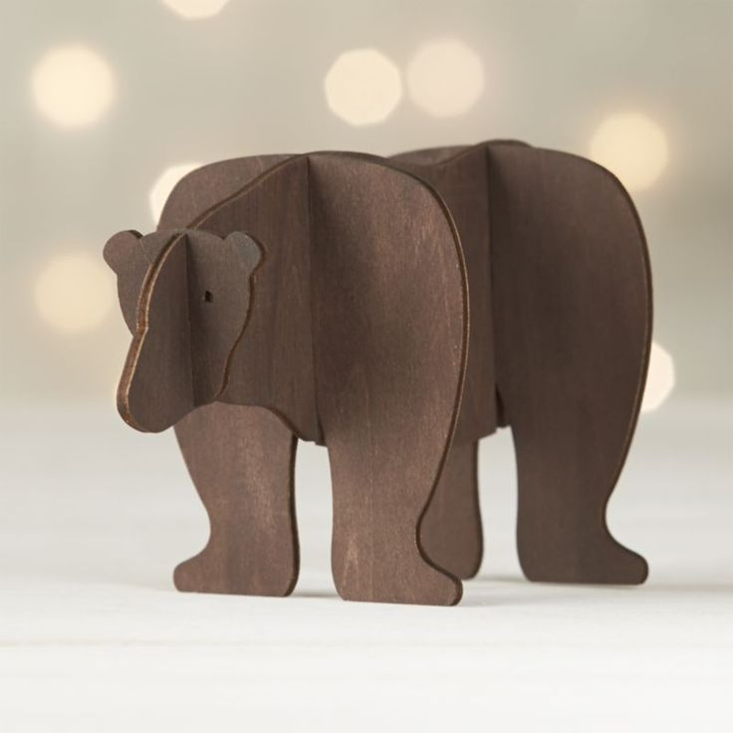
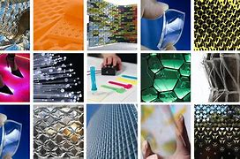
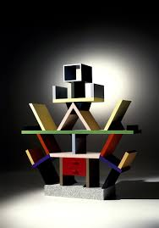
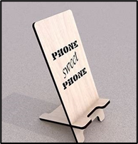
Design Technology Year 8 Learning Journey
Year 8
Materials – Wood
Mini design and make assignment. Create a flat packed animal that can be sold in the zoo shop.
Research woods, cutting and shaping techniques, prototyping, finishing skills.
Mini Project – Biomimicry, smart and modern materials.
Exploring smart and modern materials and their inspiration & creation
Design and prototype a product utilising smart & modern materials that will support survival in a given context.
C.A.D – Techsoft project – Phone stand design
Mini design and make assignment. Use of the techsoft program to design and make a phone holder.
Year 9
Design Movement - MEMPHIS
Digital presentation on the design movement Memphis. Group work.

Slide 3
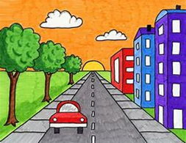
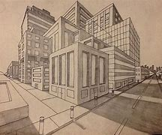
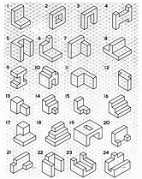
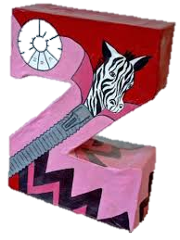
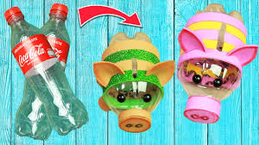
Design Technology Year 9 Learning Journey
Year 9
Technical Drawing.
Isometric, one-point and two-point perspective drawing skills.
Graphic Letter Design
A follow on from the technical drawing project. Model in card, then decorate in their own design.
Sustainability
Look at the 6 R's & their influence on designing.
The influence the 6Rs has on waste and material usage. Prepare a written report that shows how an existing product can be reused.
Year 10

