Slide 1


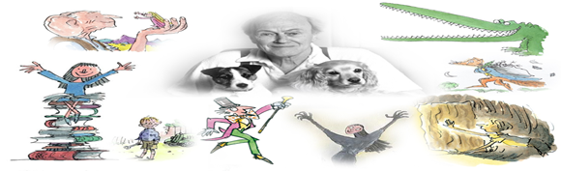
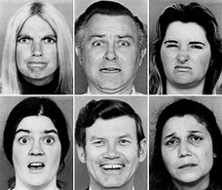



Year 7 Drama – Autumn Term: Roald Dahl
Physical Skills
Facial Expression
Drama Techniques
Tableaux: A living picture showing a moment in time as though a pause button has been pressed
Body as Prop: Using performers’ bodies to create inanimate set/props
Creating a Character: Using key information from the text to create a character different from you
Building Tension: Use of vocal and physical skills to build to
Vocal Skills:
Projection:
Ensuring your voice is loud and clear for the audience to hear.
Tone: The way you say something in order to communicate your emotions, eg, Angry, worried, shocked tone of voice.
Pace: The speed you deliver your dialogue
Pause: Moments of pause can create tension or intrigue.
Using your face to communicate character emotion and reactions.
Body Language
The way that you sit or stand. To communicate emotions or meaning to an audience
Dig Deeper Questions:
Which skills are needed for an effective tableaux and why are they important?
What clues might you look for in a text to help you to build your character?
Name 3 skills that an actor can use to create tension. Explain your choices.
Name 3 types of non-verbal communication that can be used in a performance. Now try to think of a non-performance scenario where those skills can also be useful.
Levels
Using different heights or depth to add meaning/status/ add visual interest.
Gestures
(Usually and arm or hand movement) to communicate specific meaning
Communication Cooperation Creativity Confidence

