Slide 1
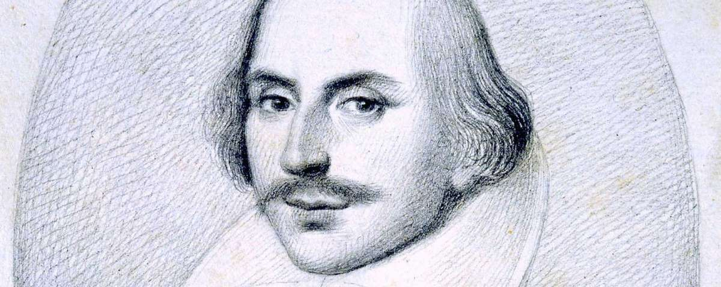
Year 8 – Autumn Term: Introduction to Shakespeare
Key Questions
• Why use prose or verse?
• How do we understand meaning without knowing every word?
How can we effectively communicate meaning to an audience?
Key Knowledge
• Shakespeare’s London was lively, noisy and home to the Globe Theatre.
• His audience was mixed – rich and poor – and actors relied on tone, gesture and expression to communicate.
• Shakespeare invented many new words and phrases.
• Iambic Pentameter = 10 syllables per line (unstressed-stressed rhythm).
• Prose is everyday speech, verse is poetic language.
• Performance skills (voice, gesture, space) help bring Shakespeare’s work to life.
Key Scenes
• Romeo & Juliet – Prologue, Balcony Scene
• Much Ado About Nothing – Opening Scene, Beatrice & Benedick
Performance Focus
• Translate scenes into modern English, then perform original.
• Use Whoosh activities and rehearsal techniques.
• Focus on voice, proxemics, and physical expression.
Examples of Shakespeare’s impact on current language:
Break the Ice – To start a conversation or interaction – The Taming of the Shrew
Wild-goose chase – A hopeless or pointless pursuit – Romeo and Juliet
Heart of gold – Someone who is genuinely kind or good – Henry V
Wear your heart on your sleeve – To openly show your emotions – Othello
In a pickle – In a difficult situation – The Tempest
The world’s my oyster – The world is full of opportunity – The Merry wives of Windsor
Green-eyed monster – Jealousy – Othello
Vocabulary
• Iambic Pentameter – 10-syllable poetic line
• Proxemics – Stage space use
• Prose – Everyday speech
• Verse – Poetic structure
• Context – Background situation
• Tone – Emotion in delivery

