Slide 1


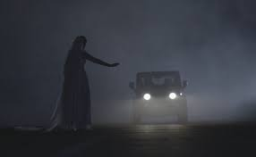
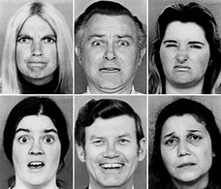

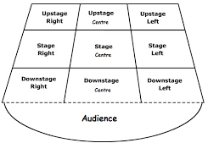
Year 8 Drama – Spring Term: Urban Legends
Drama Techniques
Teacher in Role: The teacher performs in character to the class.
Thought Track: Revealing a characters inner thoughts aloud to the audience.
Pupil in Role: Pupil performs in role during a whole class improvisation session to respond to teacher in role.
Given Circumstances: What are the facts that we know about the scene or characters?
Flash Back: Signalling to the audience that the performers are showing details of a past event/time.
Physical Skills
Facial Expression
Vocal Skills:
Projection:
Ensuring your voice is loud and clear for the audience to hear.
Tone: Try to change the tone of voice to create a change in atmosphere.
Pace: The speed you deliver your dialogue
Pause: Moments of pause can create tension or intrigue.
Emphasis: Stress key words to communicate meaning to the audience or other performers on stage.
Using your face to communicate character emotion and reactions.
Body Language
The way that you sit or stand. To communicate emotions or meaning to an audience
Dig Deeper Questions:
Origin:
Where did the stories come from?
Who told them for the first time and to whom?
Function:
What are the stories for?
Why do we tell them to each other?
Meaning:
What do the stories tell us about ourselves or our society?
Proxemics
Using space on stage to communicate meaning to an audience. Eg, standing close together can show a close relationship.
Staging
Use of working stage areas to block a scene with clear view for the audience
Communication Cooperation Creativity Confidence

