Slide 1


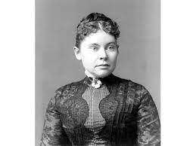
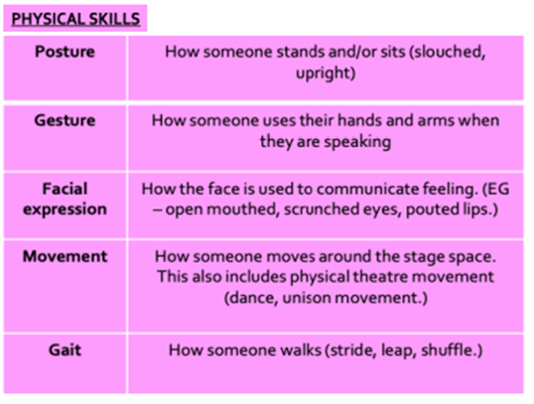
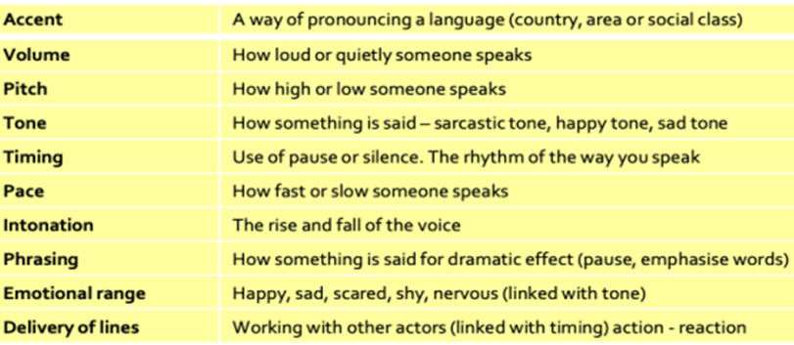
Year 9 Drama Autumn Term : Lizzie Borden
Drama Techniques
Hot Seating: Answering key questions about your character/ storyline in role
Spontaneous Improvisation: Creating a piece of Drama, based on some prior knowledge, with little or no planning time.
Documentary-Drama: A style of Drama using re-enactments of real life events.
Dig Deeper Questions:
What is a stimulus
Can you give an example of a good stimulus for a piece of Drama.
Why is a story like ‘Lizzie Borden’ a good stimulus for a piece of Drama?
What is the difference between a ‘motive’ and a ‘motif’?
Physical Skills
Vocal Skills
Communication Cooperation Creativity Confidence

