Slide 1
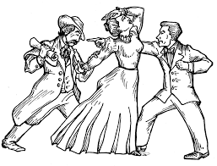
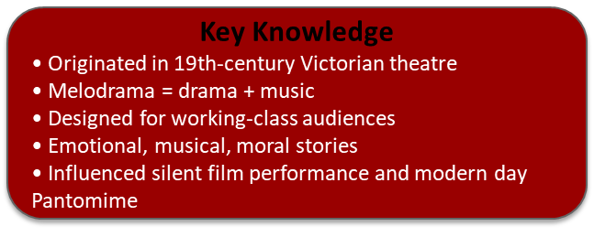
Year 8 – Summer Term – Melodrama (Victorian Style)
Victorian Melodrama was a popular style of theatre in the 19th century, especially with working-class audiences. The word melodrama means "drama with music" because performances were often accompanied by live piano or orchestral music to heighten the emotion. These plays featured clear moral messages, exaggerated acting, and dramatic storylines where good always triumphed over evil. Audiences enjoyed the recognisable stock characters like the brave hero, innocent heroine, and evil villain. Because many audience members couldn’t read or write, melodrama relied on big gestures, strong facial expressions, and dramatic music to make the story easy to follow.
Stock Characters
Hero – noble, brave Heroine – helpless, beautiful Villain – powerful, evil Comic Servant – loyal, funny Aged Parent – poor, kind
Performance Style
• Big gestures and facial expressions
• Voice: exaggerated and projected
• Movement: clear and very OTT
• Silent movie influences: placards, mime, slapstick
Key Vocabulary
• Exaggeration
• Stock Character
• Cross-Cutting
• Placards
• Stereotype
Example Scenario
• Damsel kidnapped by Villain
• Hero arrives to fight and save her
• Fight, reunion, proposal = big emotions!
Key Questions
• What are the features of melodrama?
• How can movement tell a story?
• Why are silent films linked?
• Why were stock characters effective?

