Slide 1



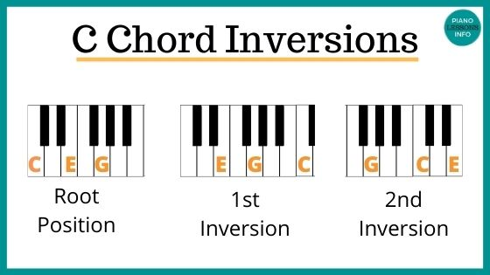
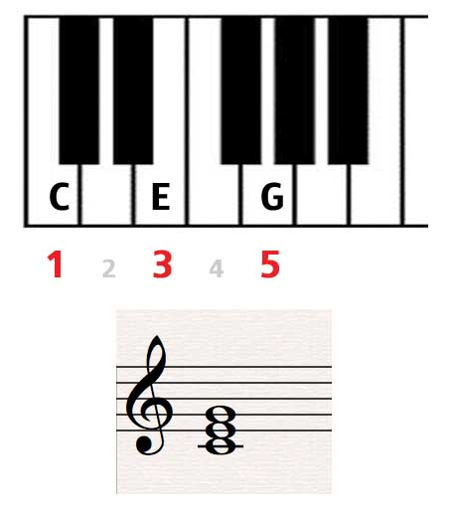
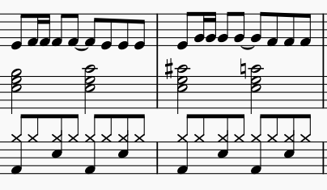
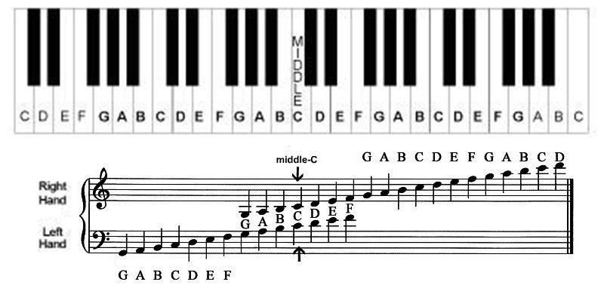
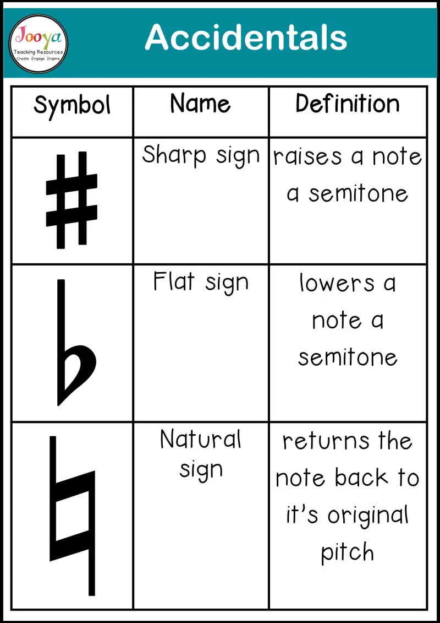
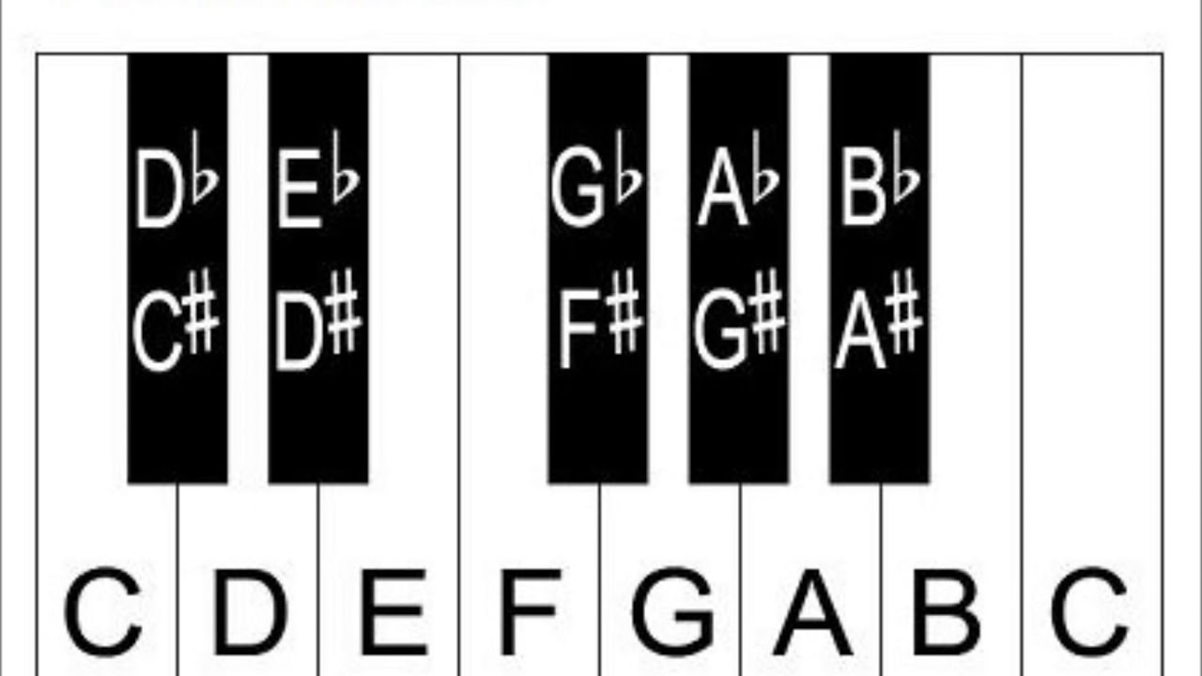
Year 8 Music: Music Tech Arrangement
SOUNDTRACK – A soundtracks is the complete collection of sounds used in a film. There are 3 main components
SOUND EFFECTS – every day sounds e.g. footsteps
MUSIC – adds drama, tension etc
DIALOGUE – speech spoken by the actors
CUE SHEET – an outline of the film used to help plan what music is needed
Chord: A group of 2 or more notes played together at the same time
Inversion: When the notes of a triad are re-arranged in a different order
Triad: A group of 3 notes played together to make a chord. It uses notes 1, 3 and 5
LEITMOTIF: A theme that represents a character
THEME: A tune that is used throughout a film.
MELODY: The tune
CHORDS: The harmony
RHYTHM: A drum beat
SUCCESS CRITERIA
Using multiple themes
Timing – music and sound effects match action
Variety of instruments
Variety of texture – layers
Combine melody, chords and rhythms
Contrasting sections showing the themes used in different ways, to match the action
Mixing – editing the tempo, dynamics etc
Composing own original ideas
Accidental: when you have to play a black note which is note part of the key

Slide 2
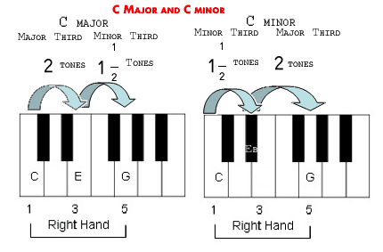
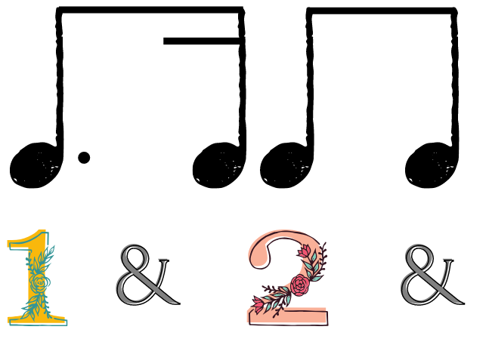
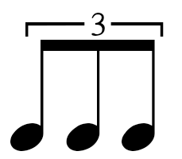



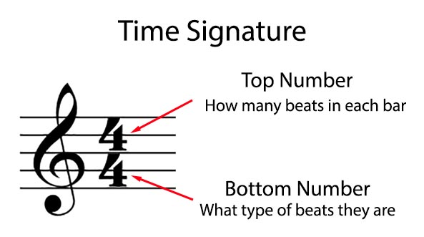
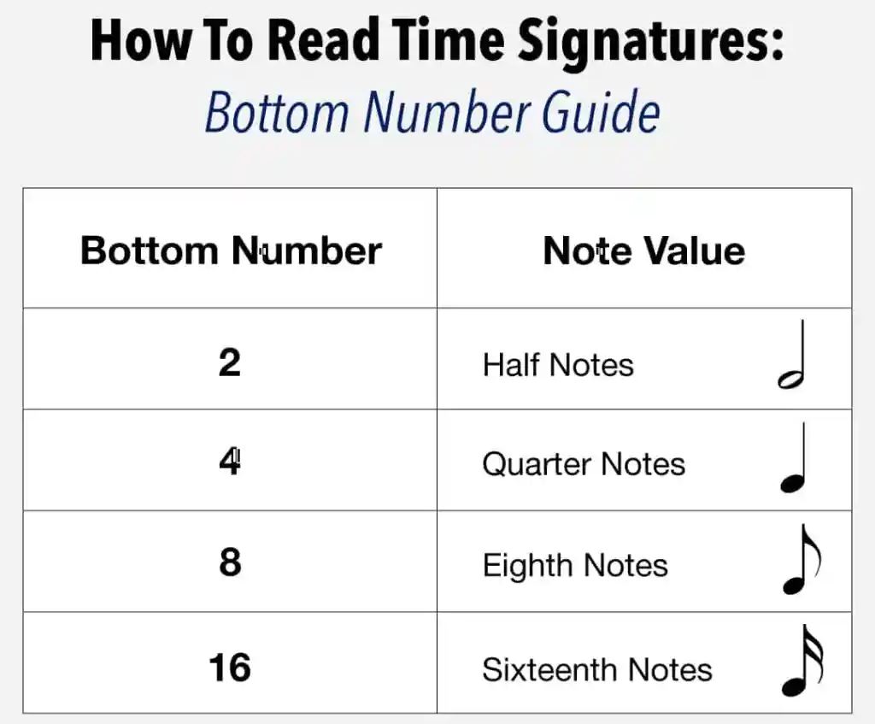
Year 8 Music: Keyboard Theme Tunes
Film Composers:
John Williams – Star Wars, Harry Potter etc
Hans Zimmer – Pirates of the Caribbean
John Barry – James Bond
Howard Shore – Lord of the Rings
Alan Menken – Beauty & the Beast, Aladdin etc
Disjunct: Tunes where the notes jump and leap
Conjunct: Tunes where the notes are smooth and next-door to each other
Major chords sound bright and happy. 😃 Minor chords sound sad and mournful. ☹️
Dotted Rhythms: Dots next
to the notes give a bouncy feel
to the rhythm
Triplet: Where you play 3 notes in the space of where you’d normally play 2
Syncopation: Off beat, jazzy rhythms
LEITMOTIF: A theme that represents a character
Pitch range: The distance between the highest and lowest notes
Accidental: when you have to play a black note which is not part of the key
Ledger Line: when the notes go above or below the stave

Slide 3
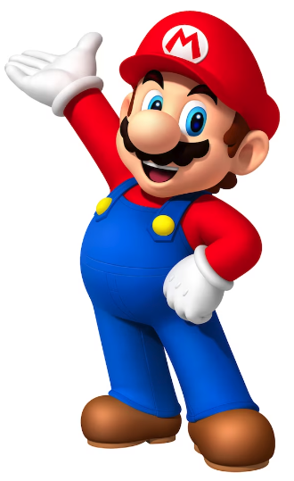
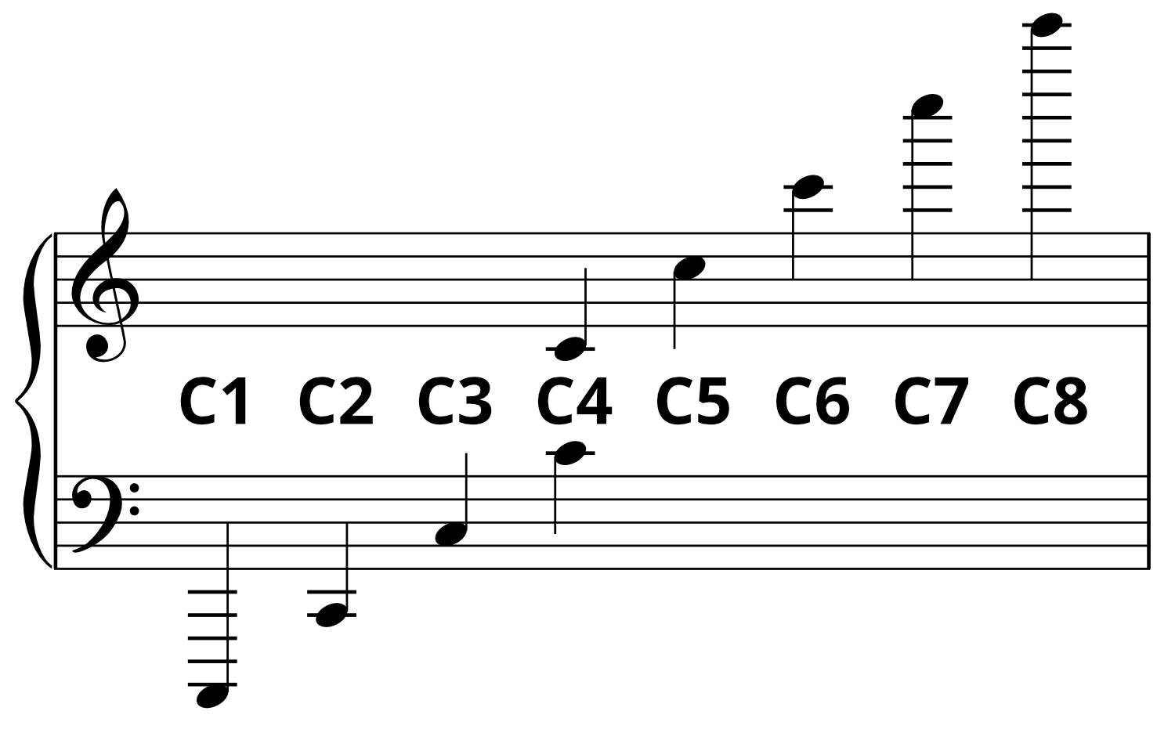
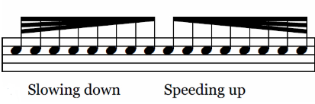
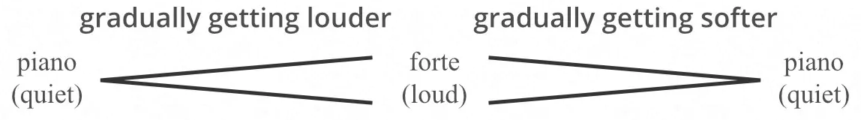


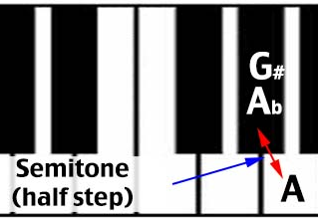
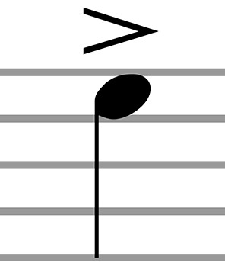
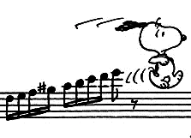
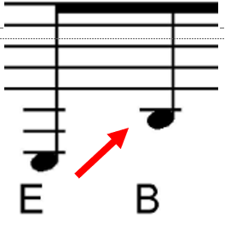
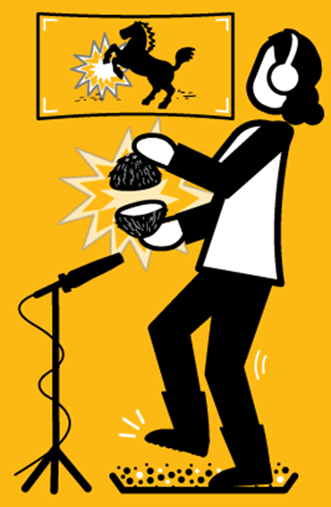
Year 8 Music: Video Games Group Composition
Pitch: The highness or lowness of a sound
Tempo: The speed of a sound or piece of music
Ritardando Accelerando
Dynamics: The volume of a sound or piece of music
Crescendo Diminuendo
Duration: The length of a sound
Texture: How much sound we hear
Silence: The opposite or absence of sound
Timbre: The unique sound quality of different instruments
Articulation: How individual notes or sounds are played
LEGATO – playing notes in a long, smooth way shown by a SLUR.
STACCATO – playing notes in a short, detached, spiky way shown by a DOT.
ACCENT – playing a note with a sudden emphasis
Structure: How a piece of music is organised into
different sections
or parts
Chromatic: When notes
move in semitones
Dissonant: Notes that clash and sound horrible together
Mickey Mousing: when the music
fits precisely with a specific
part of the action in a
film e.g. cartoons)
Drone: A long, low held note
Ostinato: A repeated pattern
Computer games use music to represent the characters and set the mood.
Character Theme – a tune to represent each character
Ground Theme – music that repeats during the titles and menus
Decision Motif – music when a character needs to make a choice
Cue – when the music lets you know something is about to happen
Sound Effect – realistic sound to match the action
MAJOR: Sounds happy
MINOR: Sounds sad
Disjunct:
leaps
Foley Artist: a person
who re-creates sounds
for film, video, and other
media in post-production
to enhance audio quality
Melody & Accompaniment: when a tune is played with backing music
Triplet: Where you play 3 notes in the space of where you’d normally play 2
Syncopation: Jazzy, off beat rhythms

Slide 4
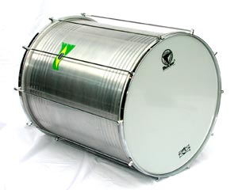
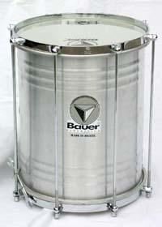
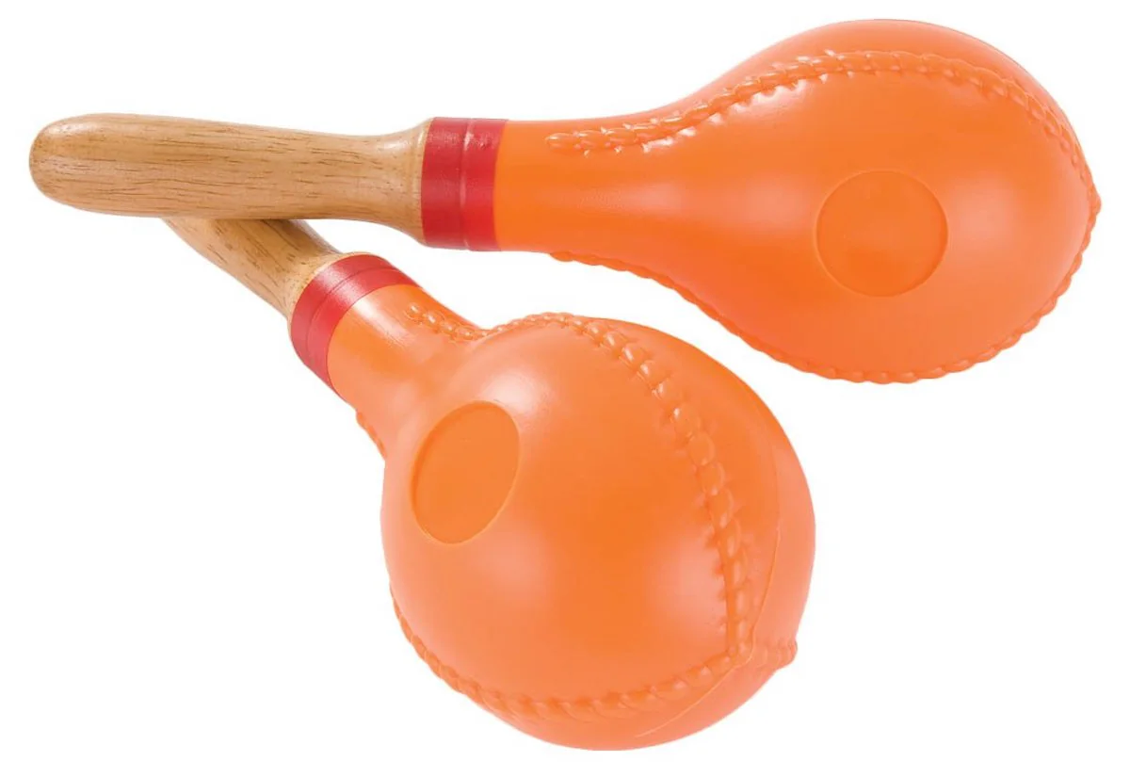
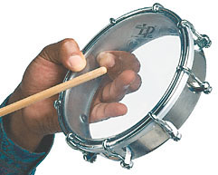
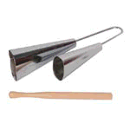
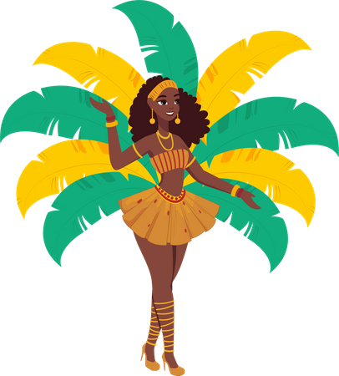
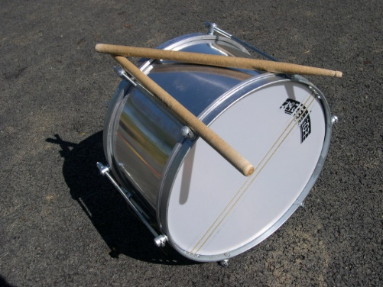
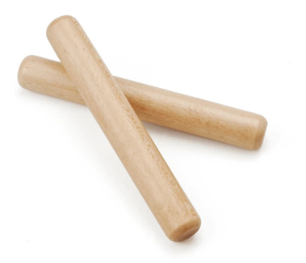
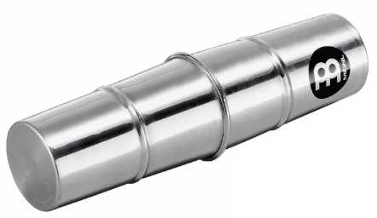
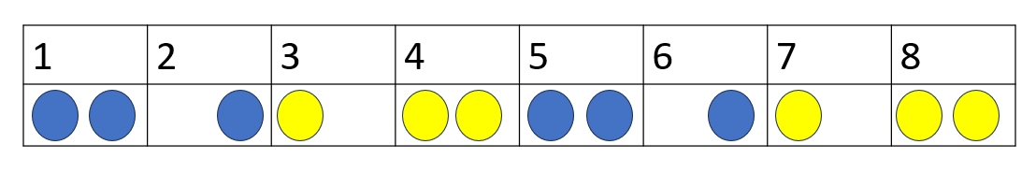
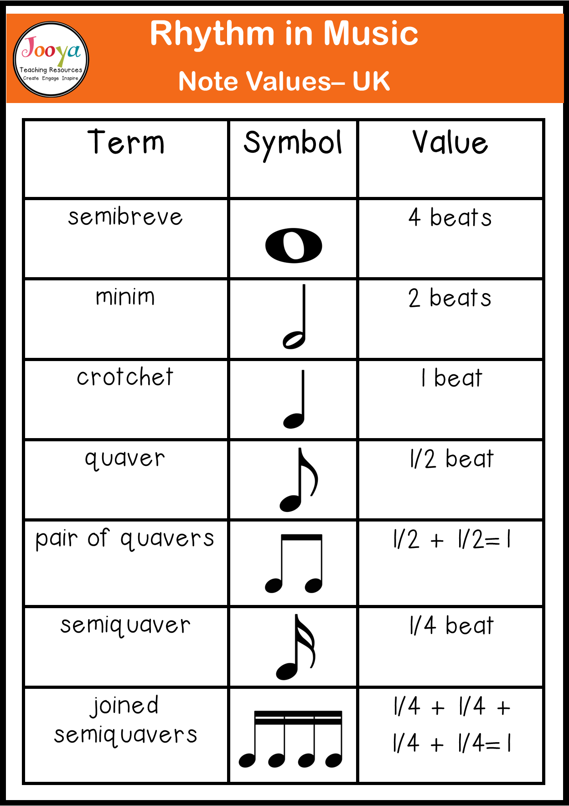
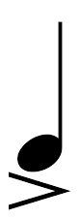

Year 8 Music: Samba Group Performance
FEATURES OF SAMBA
Brazilian Carnival Music
Loud, fast & energetic, to dance to (in fancy costumes)
Lots of drums
(percussion) and whistles
Call & Response
Syncopation and Polyrhythms (complex rhythms)
Maracas
Tamborim
Surdo
Agogo Bells
Repinique
Rhythm Grid: A grid showing the beats and when you should play
Ganza
Polyrhythm – several different rhythms performed simultaneously
Improvisation - making it up as you go along, on the spot
Call & Response – one person plays and the respond immediately after
Ostinato – a repeated pattern
Syncopation – off beat rhythm
Structure – how the music is organised, into sections
Intro – the 1st opening section
Groove – main ostinato section
Coda – ending
Crescendo – getting louder
Caixa
Claves
Accent: A strong emphasis on a note e.g. just one note played suddenly louder
Crescendo: Getting louder

Slide 5
Year 8 Music: Music Tech Composition
To be completed

Slide 6
Year 8 Music: Class Performance - Musicals
To be completed

