Slide 1


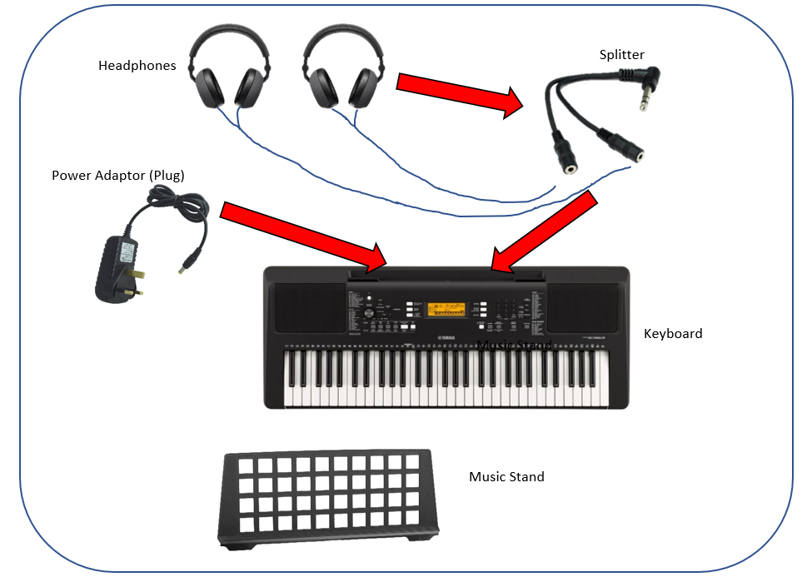
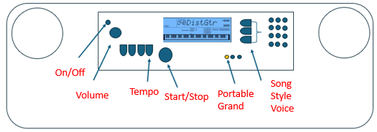
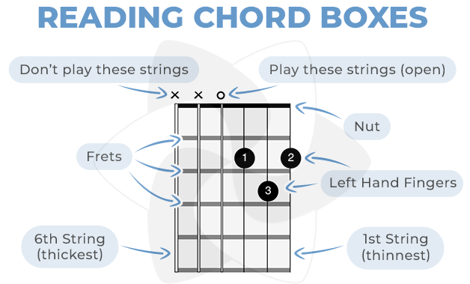
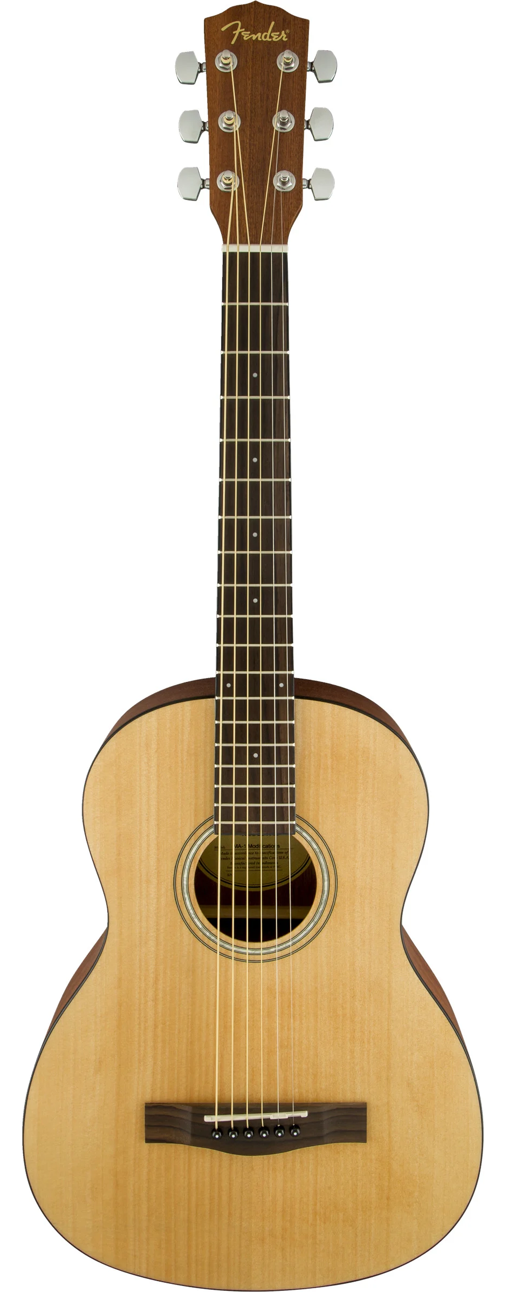
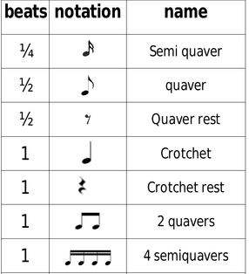
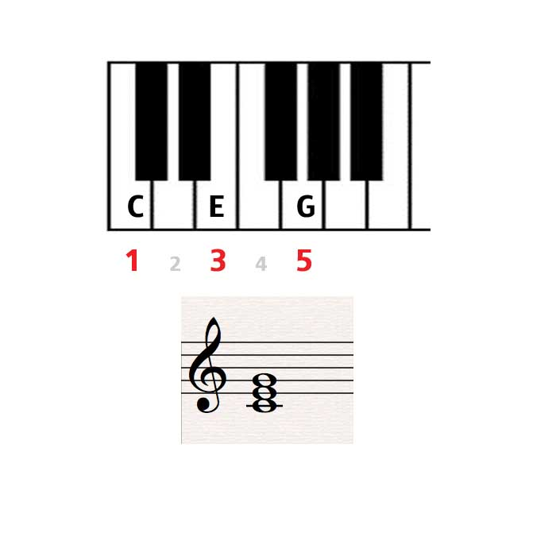
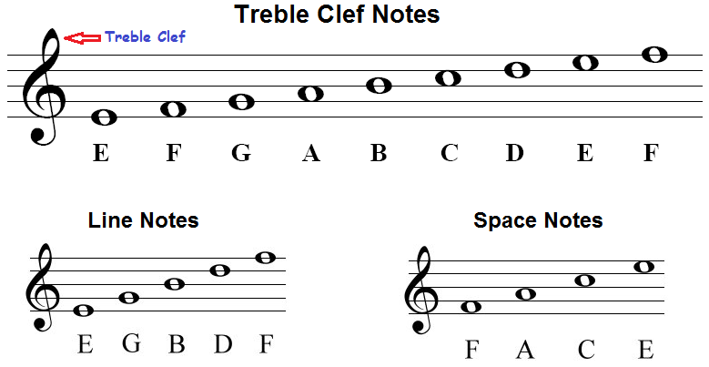
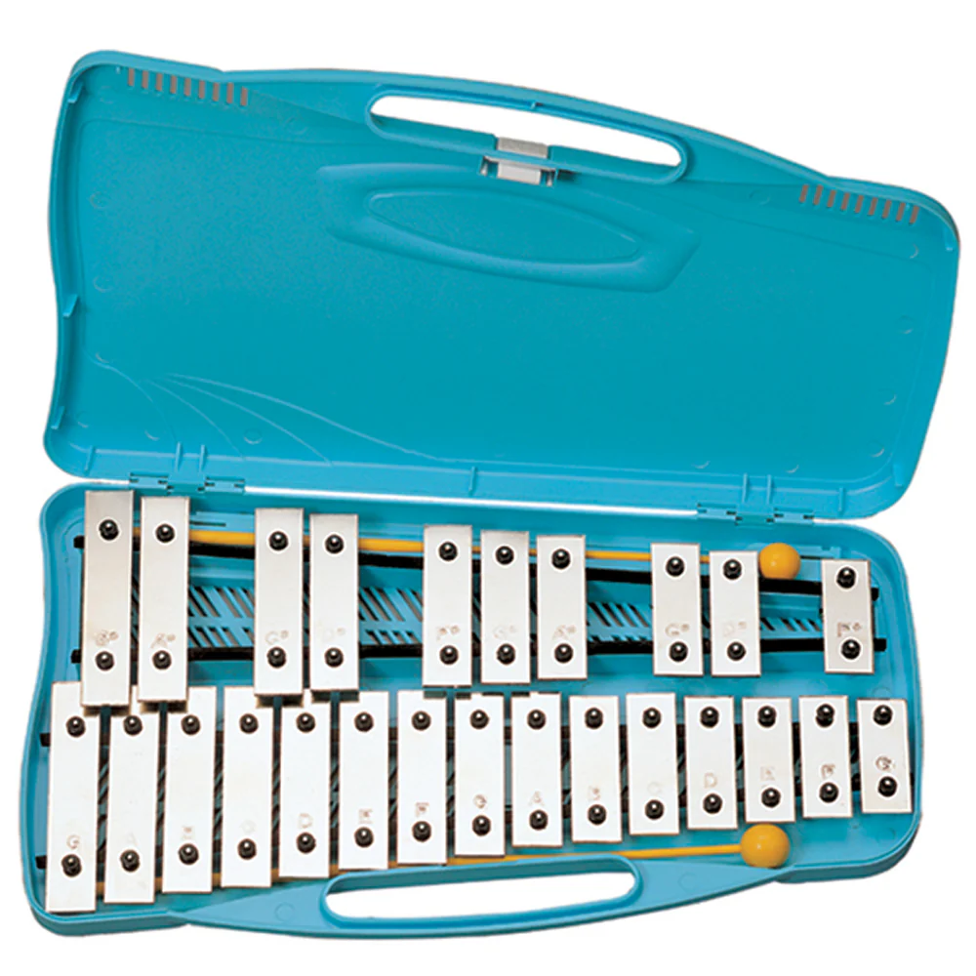
Year 7 Music Half Term 1: Class Ensemble Performance
Glossary:
Tempo – the speed of music
Beats in a bar – the number of counts
Dynamics – loud and quiet
Texture – thick or thin layers
Structure – how music is put together
Pitch – how high or low a note is
Rhythm – the pattern of long & short notes
Triad: A group of 3 notes played together to make a chord. It uses notes 1, 3 and 5
Chord: A group of 2 or more notes played together at the same time
Glockenspiel
Acoustic Guitar

Slide 2
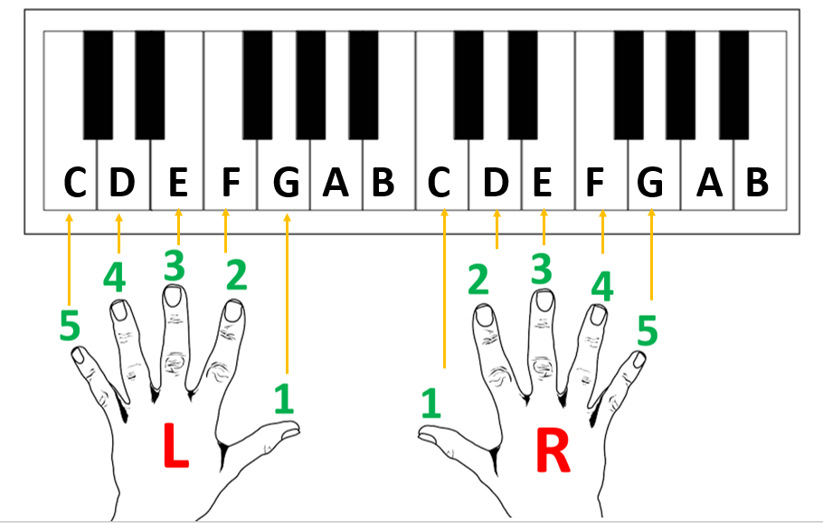
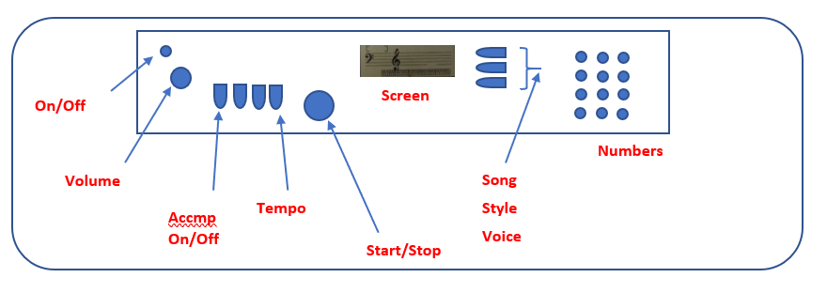
Year 7 Music Half Term 2: Keyboard Performance
Glossary:
Tempo – the speed of music
Pitch – how high or low a note is
Rhythm – the pattern of long & short notes
Technique – how well you control your instrument
Fluency – how smoothly you can play the music
Chord – 2 or more notes played at the same time
Accompaniment – music that provides a background for the main tune
MAJOR: Sounds happy
MINOR: Sounds sad
Ode to Joy Easy version: https://youtu.be/wMhu0j391rU
Ode to Joy Medium version: https://youtu.be/qrAHvk7LVoE
Ode to Joy Hard version: https://youtu.be/eC1cRedWcJM

Slide 3
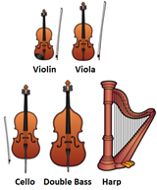

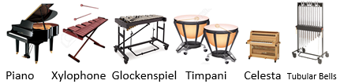

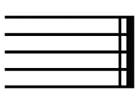

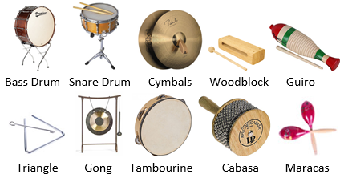
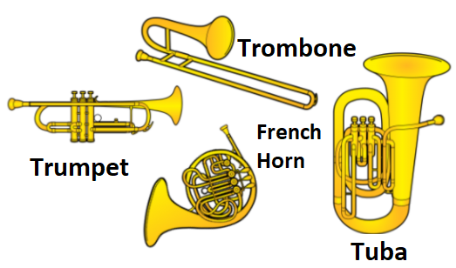
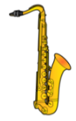
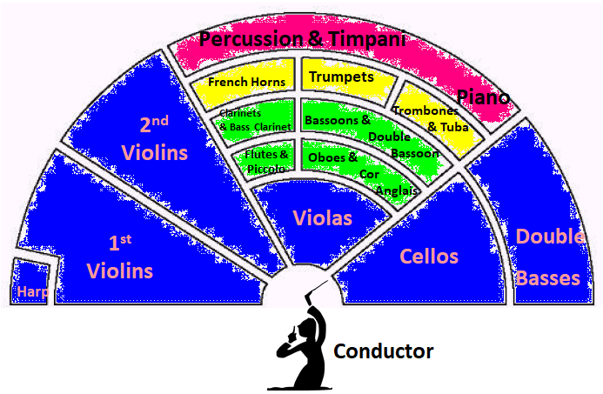
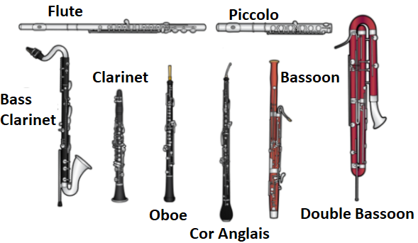
Year 7 Music Half Term 3: Ableton Orchestra
Strings Family
Largest section of the orchestra who sit at the front, directly in front of the conductor.
They all have STRINGS on them.
Usually played with a BOW (ARCO),
(not the HARP) but can be
PLUCKED (PIZZICATO).
VIOLINS split into two groups:
1st VIOLINS (often have the
main MELODY of the piece
of music) and 2nd VIOLINS.
Woodwind Family
Originally (and some still are) made from wood (some now metal and plastic). All are BLOWN.
FLUTES: Flute and Piccolo – air blown over hole.
SINGLE REED (small piece of bamboo
in the mouthpiece): Clarinet, Bass Clarinet & Saxophone (not traditionally in the orchestra, but
some modern composers
have used it)
DOUBLE REED (two
reeds in the mouthpiece):
Oboe, Cor Anglais, Bassoon,
Double Bassoon.
An Orchestra is a large ensemble (group) of instruments. They can be divided in to 4 Families: Strings, Woodwind, Brass & Percussion. A conductor leads the orchestra and beats time, often with a BATON
Brass Family
Four types of brass instruments in an orchestra, all made from METAL – usually brass and BLOWN by the player ‘buzzing their lips’ into a MOUTHPIECE (shown right).
The Trumpet, French Horn and Tuba all have three VALVES which, along with altering the players mouth positions, adjust the length of the tubing allowing for different notes to
be played. The Trombone has a
SLIDE which adjusts the length
of the tubing.
Percussion Family
Always located at the very back of the orchestra (due to their very loud sounds!). Large number of instruments which produce their sound then hit, struck, scraped, or shaken.
TUNED PERCUSSION (able to play different pitches/notes)
UNTUNED PERCUSSION (only able to produce ‘sounds’).
Staff/Staves = The 5 lines music is written on
Time Signature = Tells us how many beats are in a bar
Repeat Sign = Repeat the sections between these symbols
Double Bar line = the End
Pause = hold the note longer
Metronome = A click that keeps us in time
Tempo = Speed
Canon = A piece where the melody is copied and overlapped

Slide 4
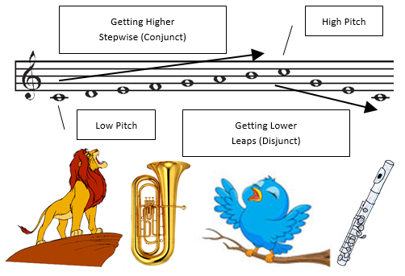
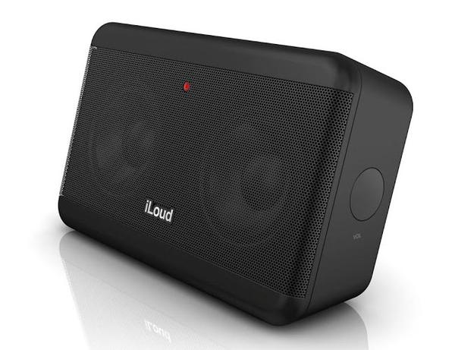
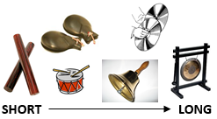
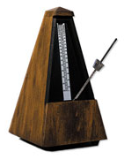
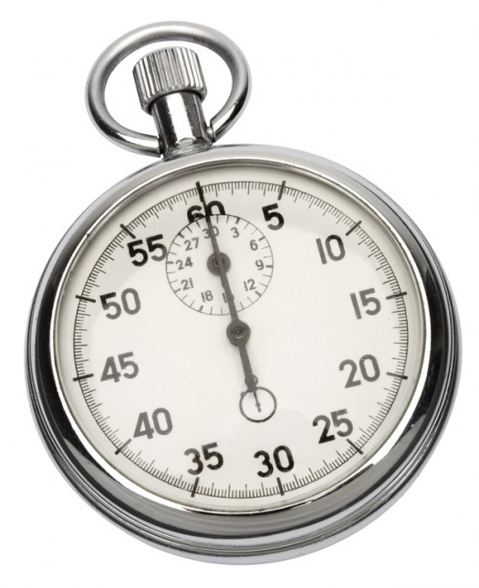







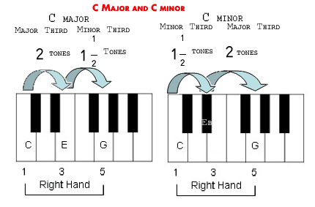
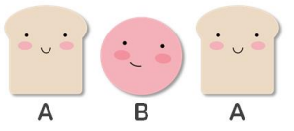

Year 7 Music Half Term 4: Ableton Composition
Pitch: The highness or lowness of a sound
Tempo: The speed of a sound or piece of music
FAST: Allegro, Vivace, Presto
SLOW: Andante, Adagio, Lento
GETTING FASTER – Accelerando (accel.)
GETTING SLOWER – Ritardando (rit.) or Rallentando (rall.)
Dynamics: The volume of a sound or piece of music
VERY LOUD: Fortissimo (ff)
LOUD: Forte (f)
QUITE LOUD: Mezzo Forte (mf)
QUITE SOFT: Mezzo Piano (mp)
SOFT: Piano (p)
VERY SOFT: Pianissimo (pp)
GETTING LOUDER: Crescendo (cresc.)
GETTING SOFTER: Diminuendo (dim.)
Duration: The length of a sound. Different length notes make up Rhythm
Texture: How much sound we hear
THIN TEXTURE: (sparse/solo) – small amount of instruments or melodies.
THICK TEXTURE: (dense/layered) – lots of instruments or melodies.
Timbre: The unique sound or tone quality of different instruments voices or sounds
Velvety, Screechy, Throaty, Rattling, Mellow, Chirpy, Brassy, Sharp, Heavy, Buzzing, Crisp, Metallic, Wooden etc.
Articulation: How individual notes or sounds are played
LEGATO – playing notes in a long, smooth way shown
by a SLUR.
STACCATO – playing notes
in a short, detached, spiky
way shown by a DOT.
Silence: The opposite or absence of sound, no sound. In music
these are RESTS
Major Chords😃
Minor Chords☹️
Structure: How a piece of music is organised into
different sections
or parts
Chord: 2 or more notes played together
Triad: A 3 note chord
Dissonant: A clashing chord
Drone: Long held note
Ostinato: Repeated pattern
Melody: A tune
Music can create an atmosphere. Music can also create an image e.g., in response to art, a story, a poem, a character, a situation – this is called PROGRAMME MUSIC.

Slide 5
Year 7 Music Half Term 5: Group Perf - African Drumming
To be completed

Slide 6
Year 7 Music Half Term 6: Group Comp - Percussion
To be completed

