Slide 1



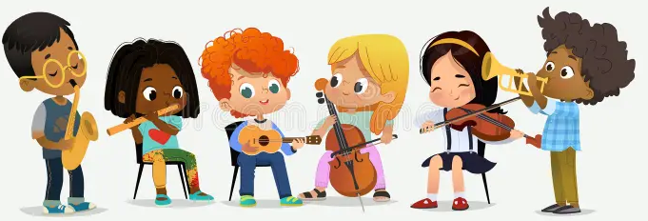


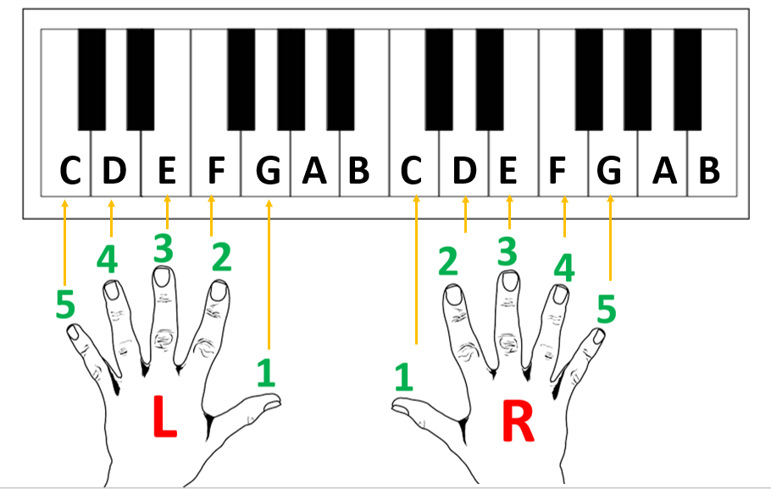


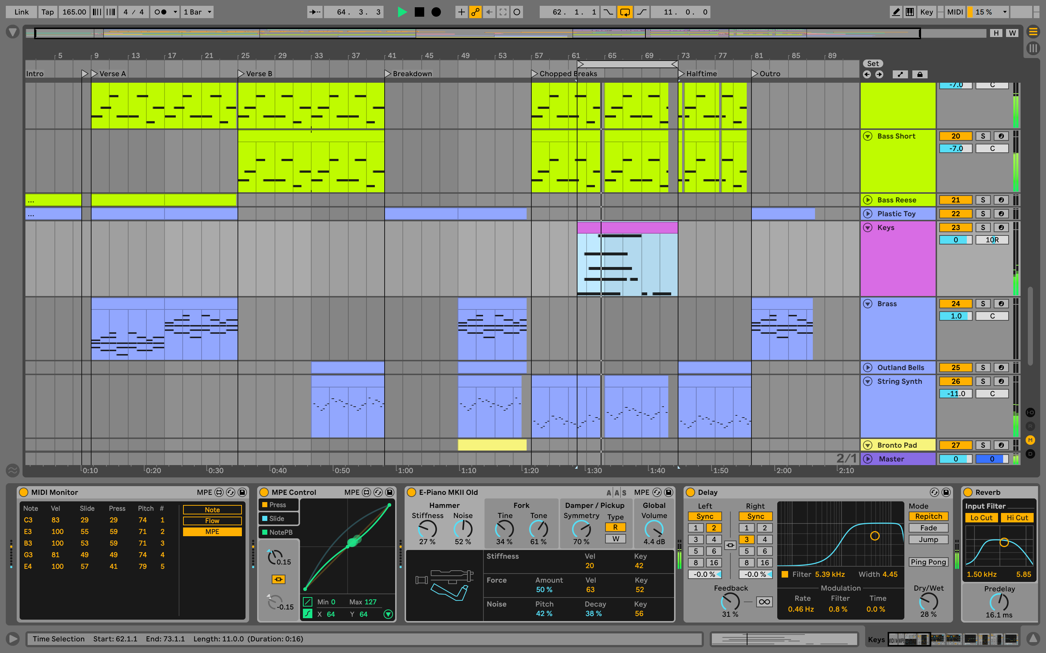
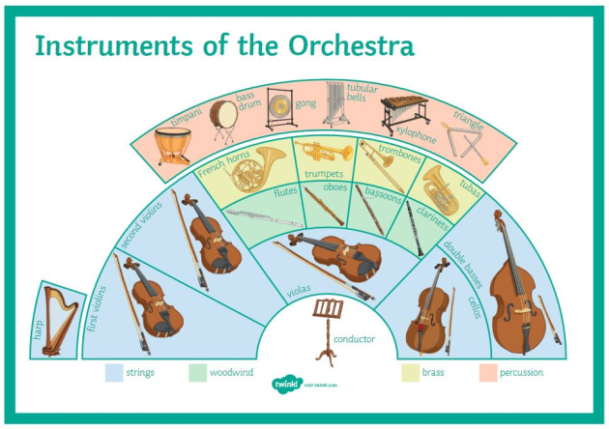


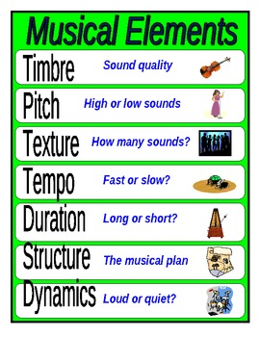

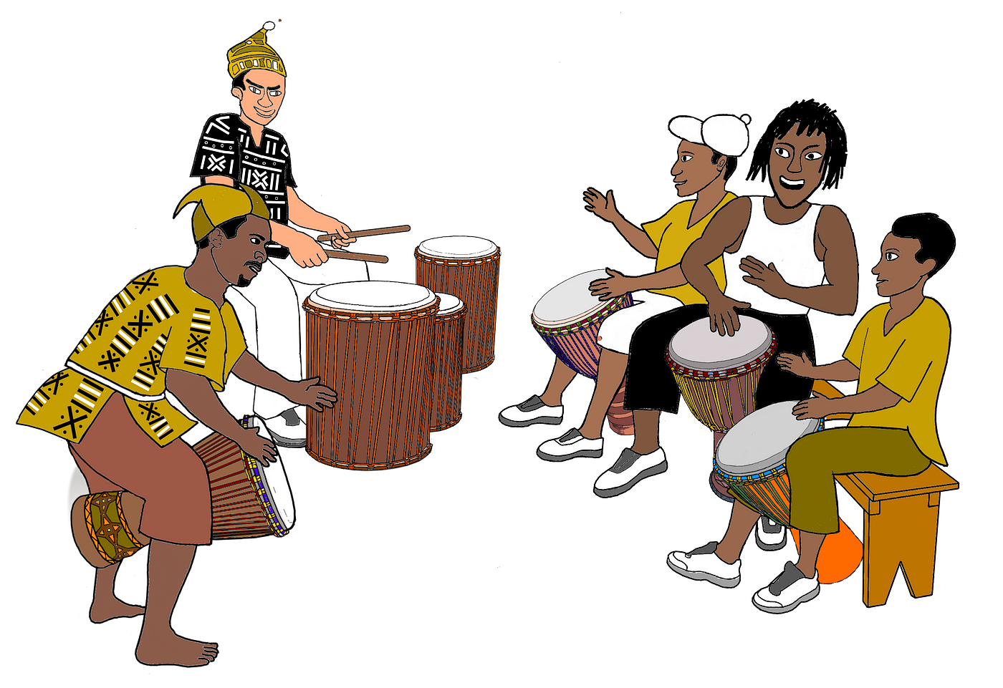
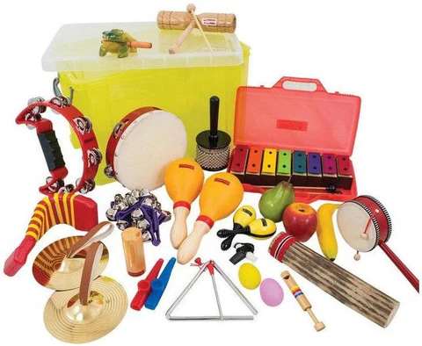
Music Year 7 Learning Journey
Year 7
Class Ensemble
Solo Performance - Keyboards
Know how to sing and play instruments together
Know how to perform a more complex piece on the keyboard
Music Tech Skills - Composition
Music Tech Skills - Orchestra
Know how to create music for a purpose, on the computer
Know how different instruments work.
Know how to use Ableton Live to recreate an orchestral piece of music
Year 8
Group Performance - African
Group Composition
Know how to arrange and perform African Music in a group
Know how to compose your own music in a group

Slide 2

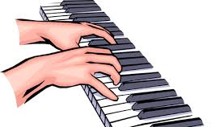

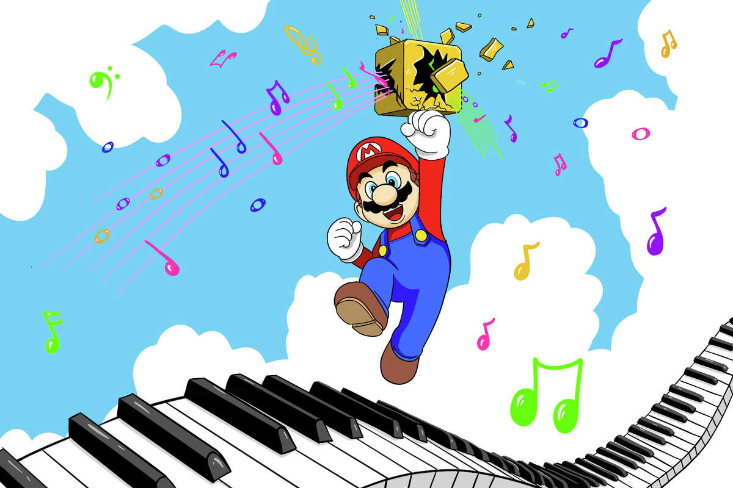

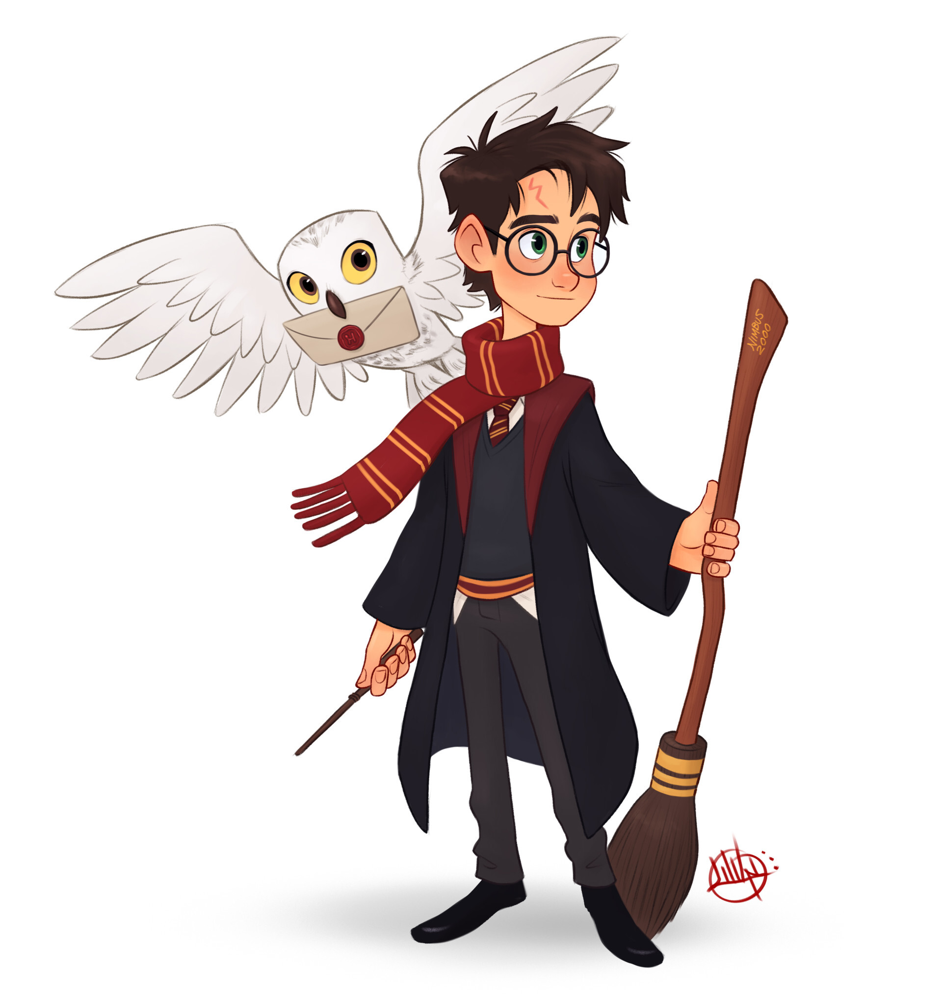
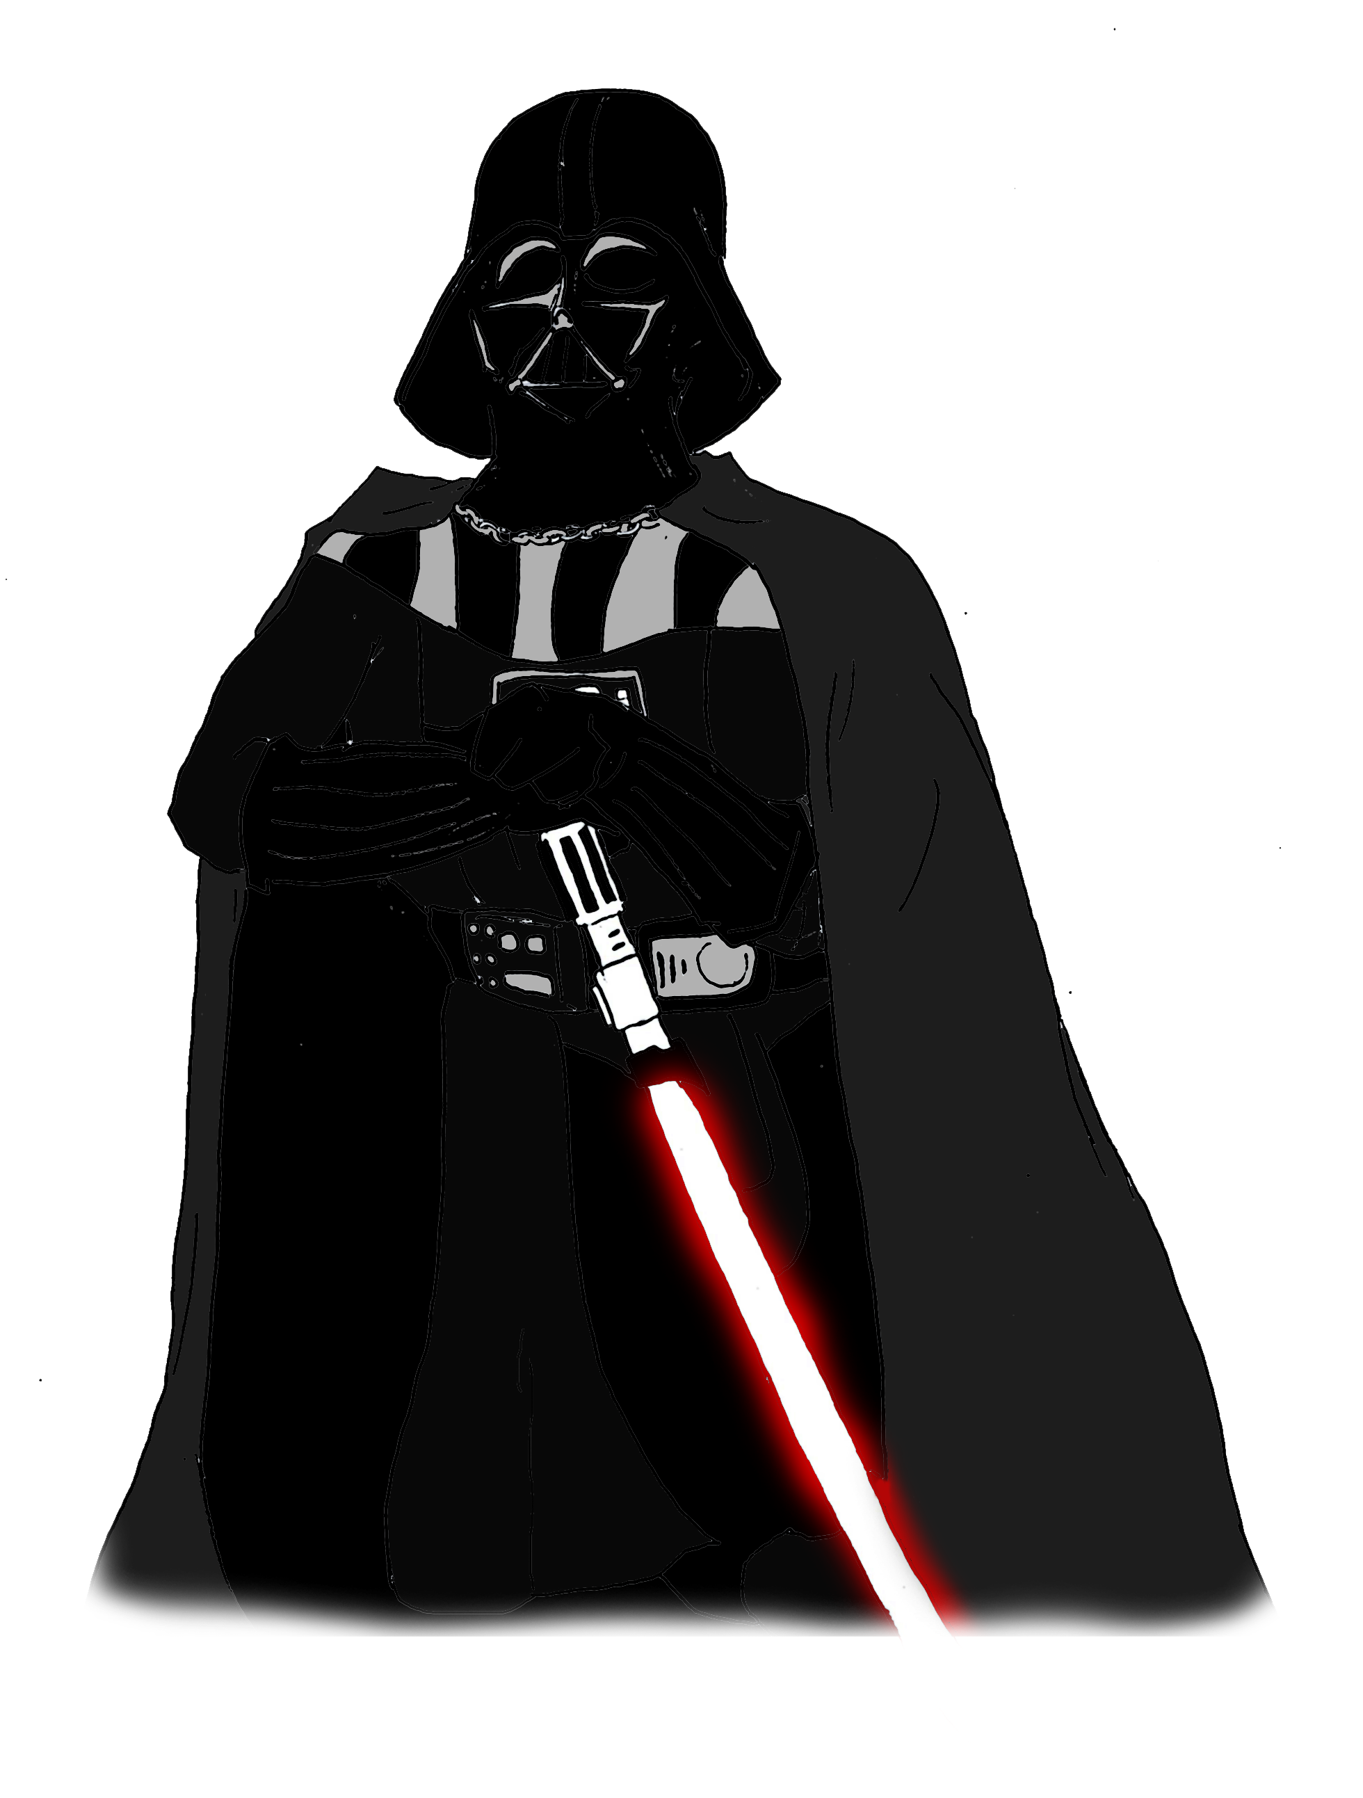

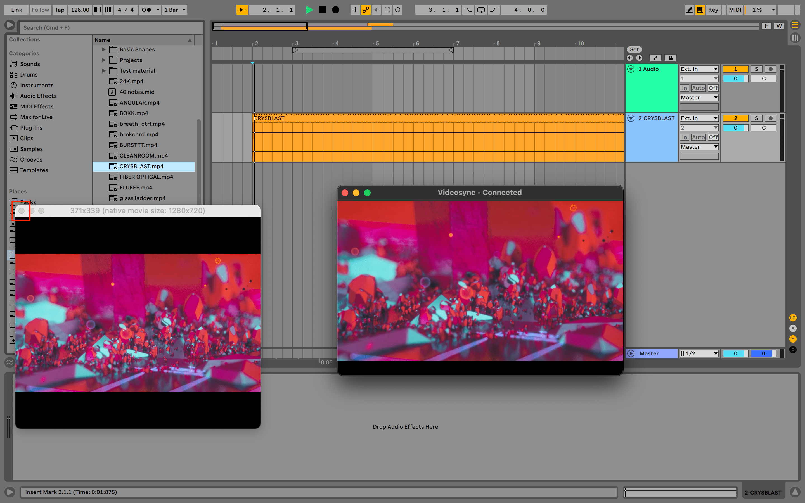

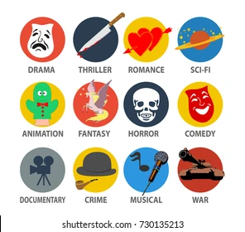



Music Year 8 Learning Journey (KB)
Year 8
Solo Performance - Keyboards
Group Composition
Know how to perform a film theme on the keyboard using both hands
Know how to compose some suitable music for a Video Game
Music Tech Skills - Arrangement
Music Tech Skills - Composition
Know how to compose your own Theme Tune
Know how to create a full soundtrack for a James Bond film clip, recording music and adding sound effects in Ableton Live
Year 9
Class Performance - Musicals
Group Performance -Samba
Know how to sing and play instruments, performing a Musical Theatre song together
Know how to arrange and perform Samba Music in a group

Slide 3
Music Year 8 Learning Journey (KB 8B1)
Year 8
Solo Performance - Keyboards
Music Tech Skills - Arrangement
Know how to perform a film theme on the keyboard using both hands
Know how to create a full soundtrack for a James Bond film clip, recording music and adding sound effects in Ableton Live
Group Performance -Samba
Group Composition
Know how to arrange and perform Samba Music in a group
Know how to compose some suitable music for a Video Game
Year 9
Class Performance - Musicals
Music Tech Skills - Composition
Know how to sing and play instruments, performing a Musical Theatre song together
Know how to compose your own Theme Tune

Slide 4
Music Year 8 Learning Journey (EV)
Year 8
Music Tech Skills - Arrangement
Group Performance -Samba
Know how to create a full soundtrack for a James Bond film clip, recording music and adding sound effects in Ableton Live
Know how to arrange and perform Samba Music in a group
Group Composition
Solo Performance - Keyboards
Know how to perform a film theme on the keyboard using both hands
Know how to compose some suitable music for a Video Game
Year 9
Music Tech Skills - Composition
Class Performance - Musicals
Know how to compose your own Theme Tune
Know how to sing and play instruments, performing a Musical Theatre song together

Slide 5

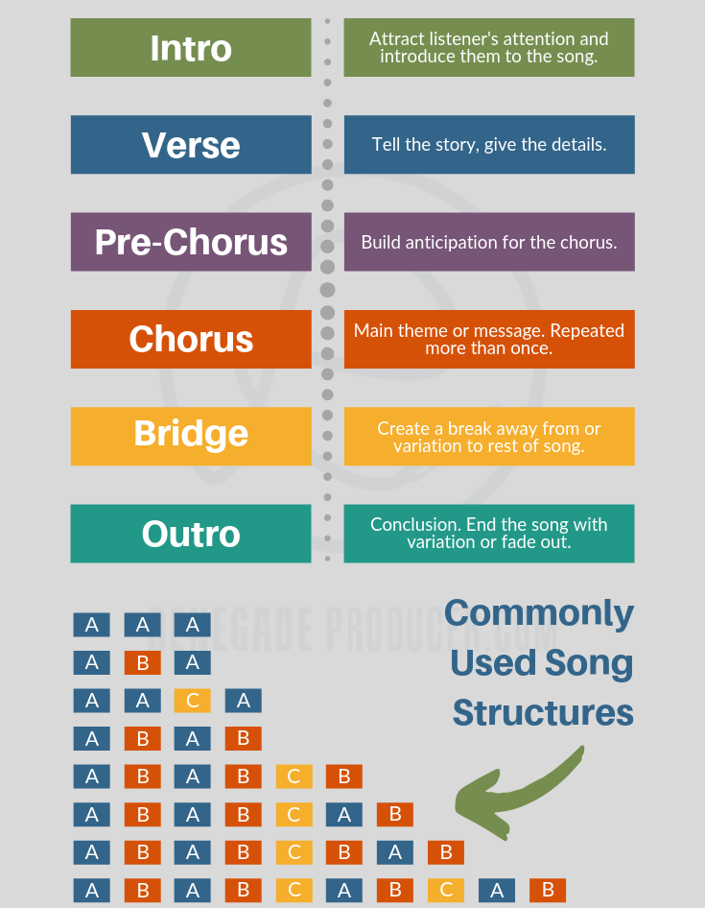

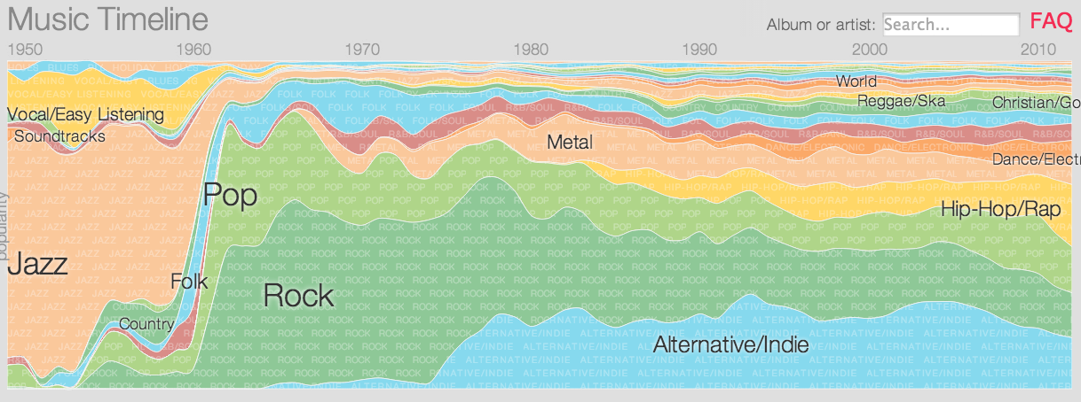
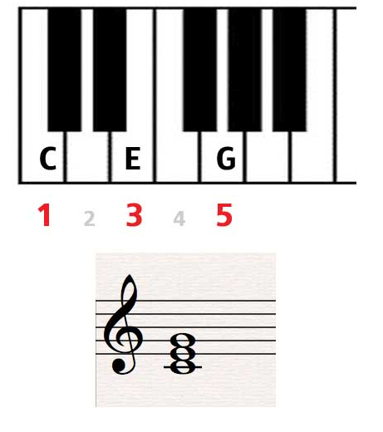
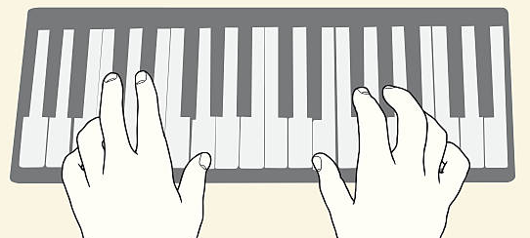
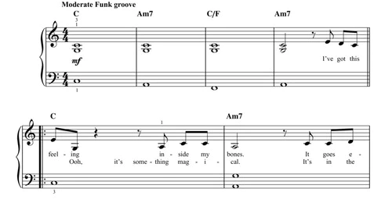
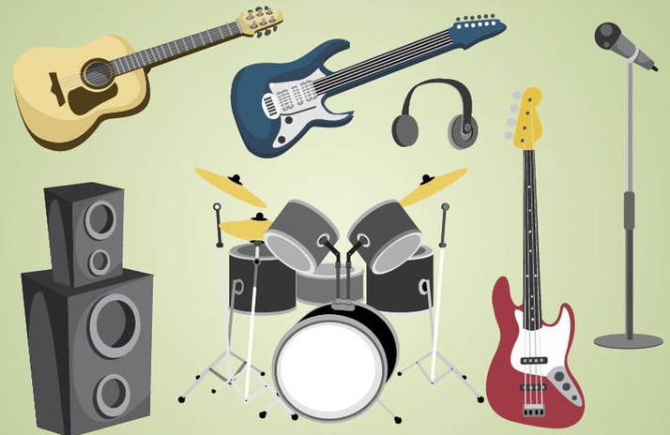
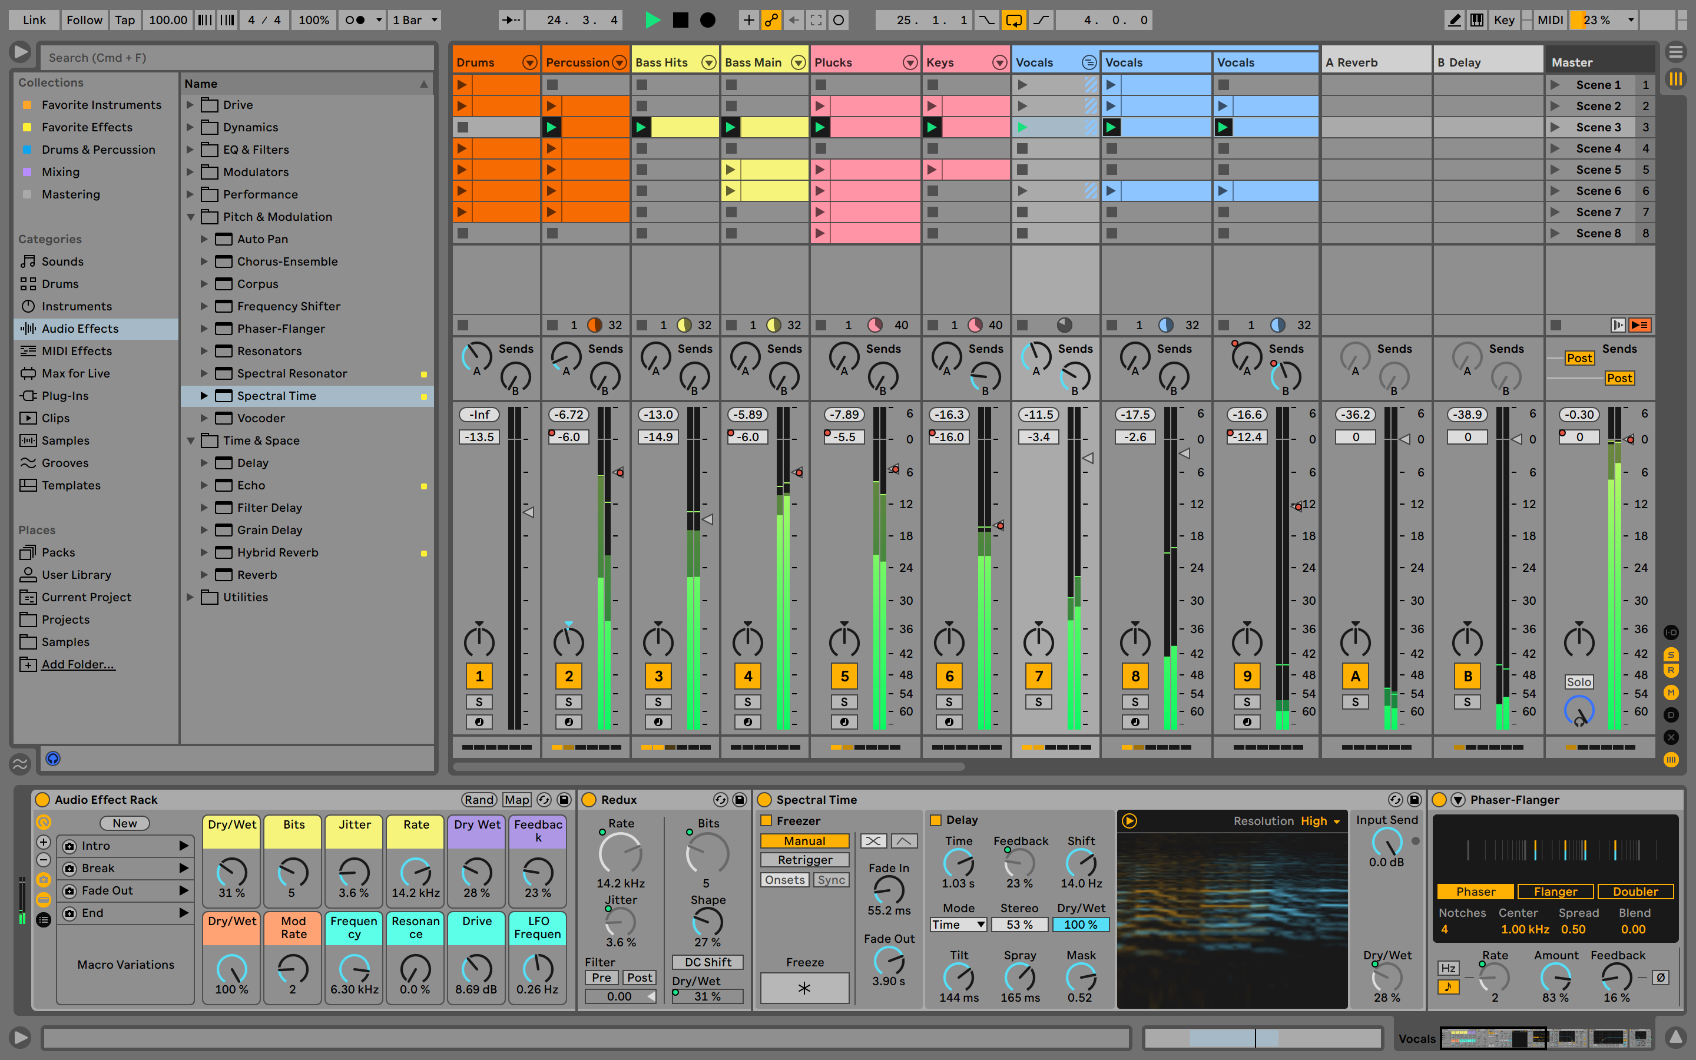
Music Year 9 Learning Journey
Year 9
Song Structure
Know about different styles of Popular Music
Know how Pop songs are structured
Know how Pop Music has evolved
Know how to re-arrange Ed Sheeran – Shape of You in Ableton Live
Pop Song Performance
Know standard Pop Instrumentation
Know how to perform a pop song on keyboard or other instrument
Know how to play in time with a backing or accompaniment
Know how to develop performance & ensemble skills
Year 10
Pop Music Composition
Know how to create own Pop song composition in Ableton Live
Compose & improvise chords, basslines and melodies, using a clear structure

