Slide 1



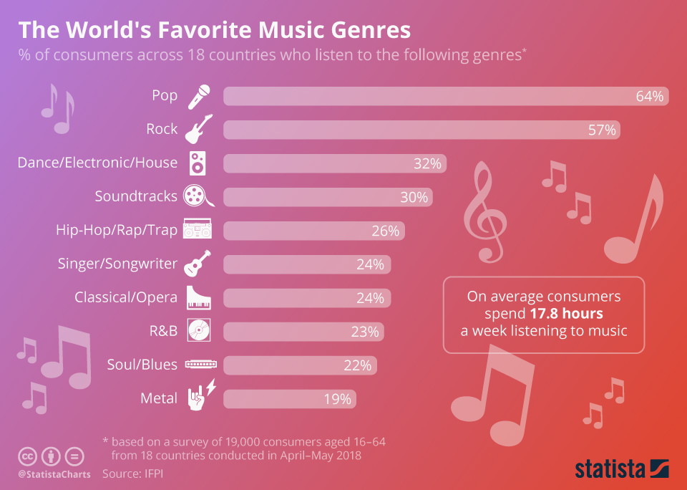
Year 9 Music Term 1: Pop Song Structure
INTRO | the first section of a song which sets the mood of the song and is often an instrumental section
VERSES | has the same melody but different lyrics each time which helps develop the song’s narrative and story
LINK | a optional short section often used to join different parts of a song together, often instrumental
PRE-CHORUS | an optional section of music that occurs before the CHORUS which helps the music move forward and “prepare” for what is to come.
CHORUS | occurs several times within a song and contains the most memorable HOOK/RIFF. Relays the message of the song and is repeated with the same melody and lyrics each time it is heard
MIDDLE 8/ BRIDGE | a section (often 8 bars in length) that provides contrasting musical material
CODA/ OUTRO | The final section of a popular song which brings it to an end
STRUCTURE: The way music is put together in sections. Pop Songs have typical sections e.g. verses/choruses, but there is no set order. Each artist likes to create their own structure
GENRE: A style or category.
There are thousands of different styles or genres and each style has it’s own unique features e.g.
Pop
Rock
Hip Hop
Jazz
Blues
Metal
Country
Reggae
Dance
RnB
COPYRIGHT is the legal right to own a piece of intellectual property e.g. songs, stories etc. It stops others from copying without permission.
COMPOSITION KEYWORDS
Timing – triggering loops at the correct time
Texture – the number of layers at the same time e.g. 1 sample, 3 samples or 7 samples all playing at the same time
Contrasts – changing things so it sounds different to the original
Capturing Scenes – a method on Ableton Live where you group samples to make a new section
Muting - where a sample (or all samples) are silenced for a period of time.
Arrange – where you take something you did not create and put it together differently to make your own version

Slide 2
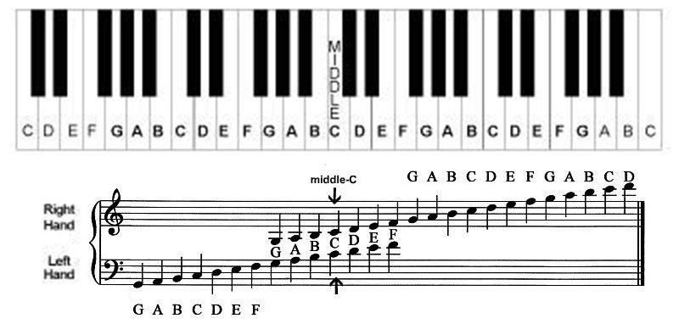
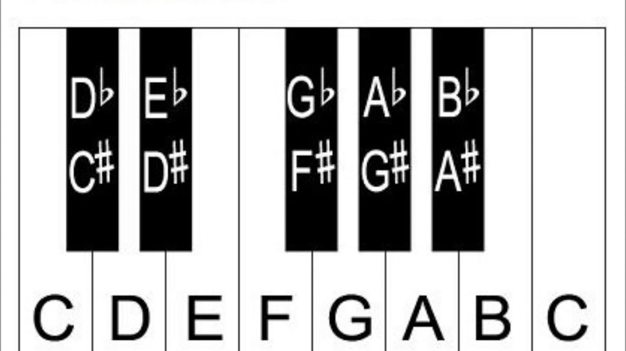
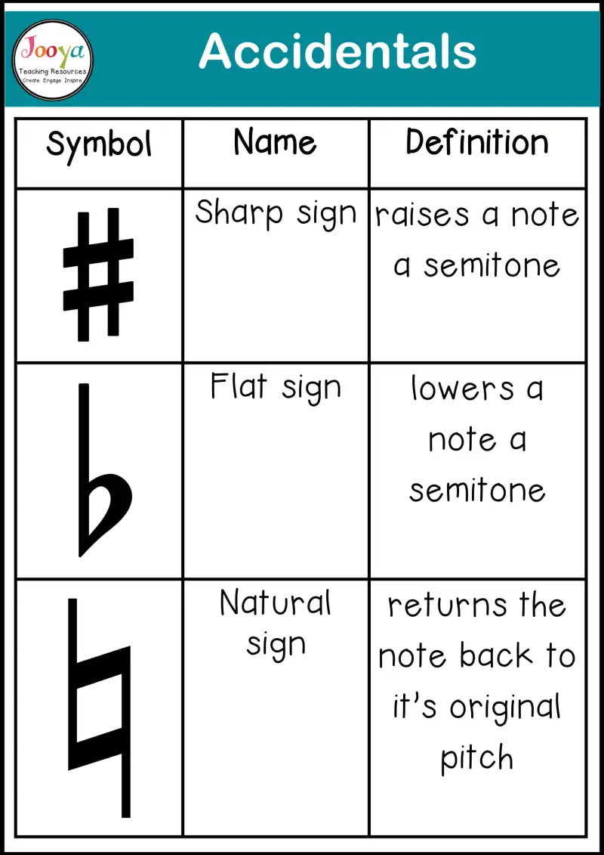
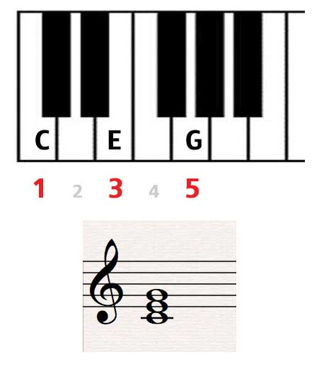
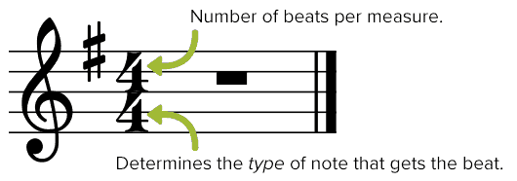
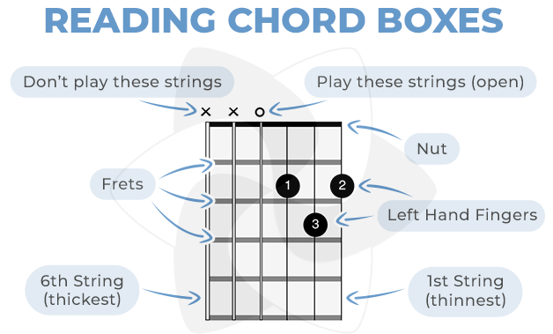
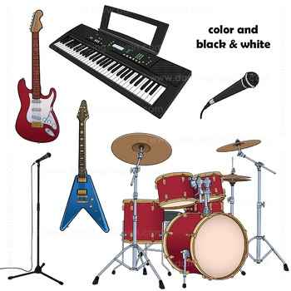
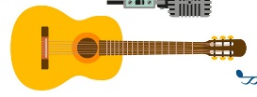
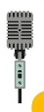


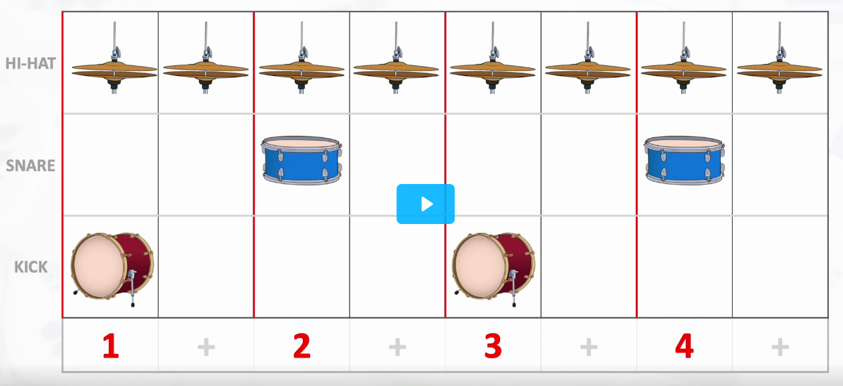

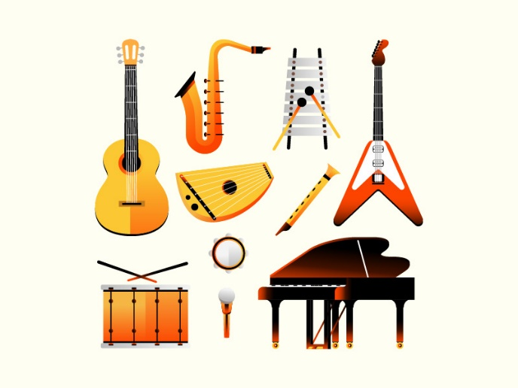
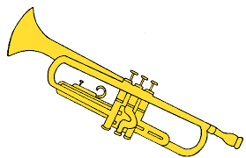
Year 9 Music Term 2: Pop Song Performance
Chord: A group of 2 or more notes played together at the same time
Triad: A group of 3 notes played together to make a chord. It uses notes 1, 3 and 5
Time Signature: These numbers tell you how many beats are in a bar
Rock & Pop Instruments
q
Electric Guitar Acoustic Guitar Singers
Bass Guitar Keyboard / Synthesizer
Drum Kit Saxophone Trumpet
Lead instrument = Often an electric guitar (‘lead guitar’). Plays melody or harmonises with the singer & often has a solo.
Tempo – the speed of music
Pitch – how high or low a note is
Rhythm – the pattern of long & short notes
Technique – how well you control your instrument
Fluency – how smoothly you can play the music
Accompaniment – music that provides a background for the main tune
Chord Symbols:
A single letter means play a major chord e.g. C = C E G.
A small m means play a minor chord e.g. Cm = C Eb G
Right stick
Left stick
Right foot
Count these beats

Slide 3
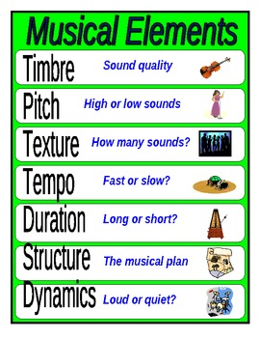

Year 9 Music Term 3: Pop Song Composition
SAMPLE: A sample is a short extract of pre-recorded music created by someone else.
Samples can be used in combinations to create a whole new piece of music. They can be
EDITED
CHOPPED UP/TRIMMED
LOOPED
LAYERED
SPED UP/SLOWED DOWN
INTRO | the first section of a song
VERSES | has the same melody but different lyrics each time
LINK | a optional short section often used to join different parts of a song together, often instrumental
PRE-CHORUS | an optional section of music that occurs before the CHORUS which helps the music move forward and “prepare” for what is to come.
CHORUS | occurs several times within a song and contains the most memorable HOOK/RIFF. Relays the message of the song and is repeated with the same melody and lyrics each time it is heard
MIDDLE 8/ BRIDGE | a section (often 8 bars in length) that provides contrasting musical material
CODA/ OUTRO | The final section of a popular song which brings it to an end
MIDI – Musical Instrument Digital Interface = how computers and keyboards communicate
Audio – real recorded sounds
COMPOSITION KEYWORDS
Timing – triggering loops at the correct time
Instruments – use a variety of instrument sounds
Texture – the number of layers at the same time e.g. 1 sample, 3 samples or 7 samples all playing at the same time
Contrasts – changing things so it sounds different to the original
Capturing Scenes – a method on Ableton Live where you group samples to make a new section
Muting - where a sample (or all samples) are silenced for a period of time.
Arrange – where you take something you did not create and put it together differently to make your own version
Automated changes – programming the volume or speed so that it automatically changes
Improvise – create some music on the spot
BASS LINE – the part of the music with the lowest pitch, usually played by a bass guitar
CHORDS – a group of notes played together, often played by keyboards, piano or guitar
MELODY – the main tune, usually sung but can be played by a melody instrument e.g. trumpet, saxophone, piano etc.
BEATS – the rhythmic part usually played by drum kit or drum machine
Fusion
Fusion means to blend together
Fusion music is a blend of 2 or more different styles or cultures
Styles examples = Rock, Hip Hip, Classical, Soul
Cultures examples = Chinese, Indian, Caribbean etc
Fusion examples = Chinese Rock, Classical Indian, Caribbean Hip Hop etc

